Slide 1

Windows 7 for Information Workers
NetCom SME: Neil Masih

Slide 2
Windows 7 for Information Workers
Working with Windows
Using the Taskbar and Jump Lists
Finding and Organizing Information
Using BitLocker To Go
Advanced System Recovery
LIVE DEMO

Slide 3
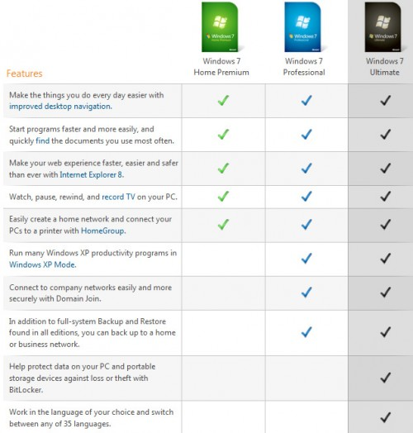
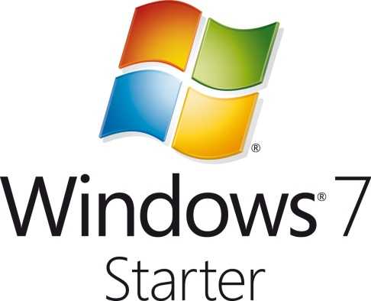
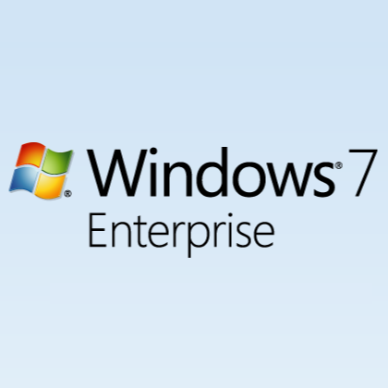
Editions of Windows 7
Notes:
Key message: There are six Windows 7 editions. Two for mainstream consumers and business users and four specialized editions for enterprise customers, technical enthusiasts, emerging markets and entry level PCs.
This is a build slide. Step through the each frame of the build slide as you cover the editions of Windows 7, their purpose and key features.
The first frame shows all the six editions, and how they are positioned. Talk about each briefly, do not spend too much time on this subject since the subsequent frames unfold all the editions in more detail.
The second frame shows how all the editions stack up based on their included features. As you step through the subsequent frame, each edition being discussed is highlighted in this stack.
Windows 7 Starter: Run through this edition purpose and key features.
Windows 7 Home Basic: Run through this edition purpose and key features.
Windows 7 Home Premium: Run through this edition purpose and key features.
Windows 7 Professional: Run through this edition purpose and key features.
Windows 7 Enterprise: Run through this edition purpose and key features.
Windows 7 Ultimate: Run through this edition purpose and key features.
The last frame shows all the six editions again. Here summarize the editions of Windows 7.
Additional information: Ensure that your students are aware what the N editions provide.
Also, refer to: http://go.microsoft.com/fwlink/?LinkID=154223
Question: Which edition of Windows 7 might you choose in the following scenarios?
Scenario 1: There are a few users in your organization. Currently, you do not have a centralized file server and all of the computers are not joined to a domain.
Scenario 2: Your organization has more than one hundred users who are located in several offices across the country. In addition, you have several users that travel frequently.
Answer: Choose Windows 7 Professional for Scenario 1 and Windows 7 Enterprise for Scenario 2.
Scenario 1: For a business environment, choose either Windows 7 Professional or Windows 7 Enterprise. Windows 7 Home Premium, Windows 7 Home Basic, and Windows 7 Starter are targeted for home users. Because you only have few users, Windows 7 Professional will be the best fit.
Scenario 2: Choose Windows 7 Enterprise and take the advantage of features such as BranchCache and DirectAccess to increase the productivity of your mobile users.
Question: What is the difference between the Enterprise and the Ultimate edition of Windows 7?
Answer: There is no difference in terms of features between the Enterprise and Ultimate editions. Windows 7 Enterprise is available through Microsoft Software Assurance with Volume Licensing and Windows 7 Ultimate is available through the retail channel. There is no upgrade path between the two.

Slide 4
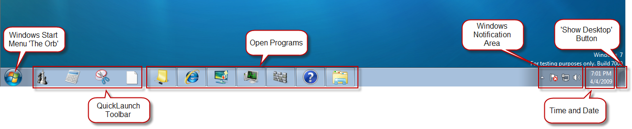
Using the Taskbar and Jump Lists
Taskbar
  The new Windows 7 taskbar is still the same familiar place for switching between windows. But now it's easier to see, more flexible, and more powerful
    Pinning
    Live taskbar previews
    Jump Lists

Slide 5
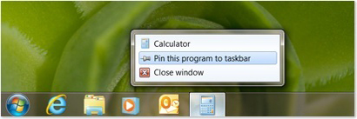
Using the Taskbar and Jump Lists
Pinning
  In Windows 7 you can pin favorite programs anywhere on the taskbar for easy access.
  You rearrange them any way you like by clicking and dragging.
  You can even pin individual documents and websites to Jump Lists on your taskbar.

Slide 6
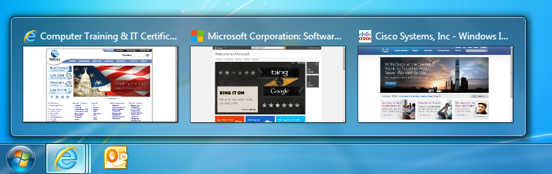
Using the Taskbar and Jump Lists
Taskbar Preview
  You can point to a taskbar button to see a live preview of its open windows, including webpages and live video.
  Move your mouse over a thumbnail to preview the window full screen, and click it to go open the window.
  You can even close windows and pause video and songs from the thumbnail previews, which can be a big time saver.
  Live taskbar previews are available only in the Home Premium, Professional, Ultimate, and Enterprise editions of Windows 7.

Slide 7
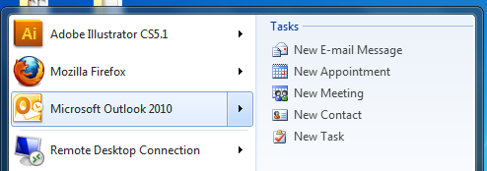
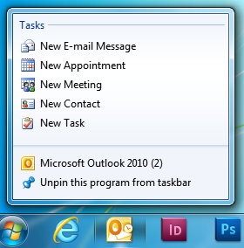
Using the Taskbar and Jump Lists
Jump Lists
  They take you right to the documents, pictures, songs, or different options.
  To open a Jump List, just right-click a program button on the Windows 7 taskbar. (You can also get to Jump Lists by clicking the arrow next to the program name on the Start menu.)
  The Jump List depends entirely on the program.
  Jump Lists don't just show shortcuts to files. Sometimes they also provide quick access to commands

Slide 8
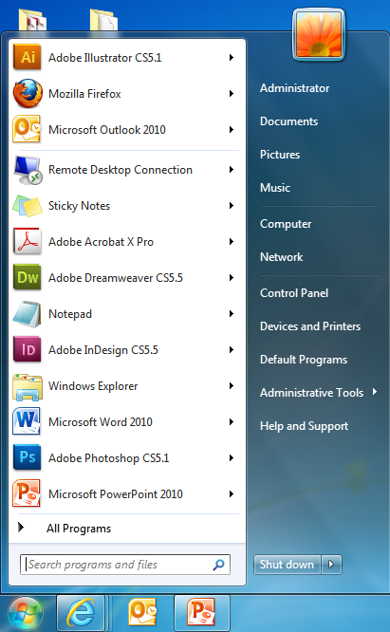
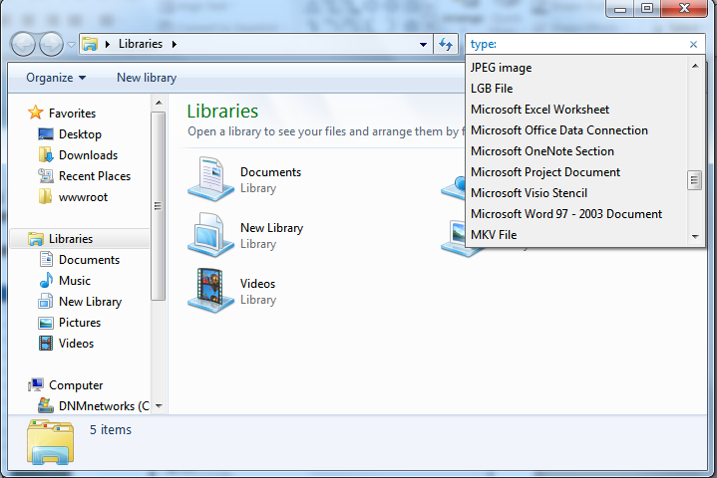
Finding and Organizing Information
Search
  In Windows 7, you can find more things in more places. Items like documents, email messages, songs pictures.
  The new search lets you do it faster.

Slide 9
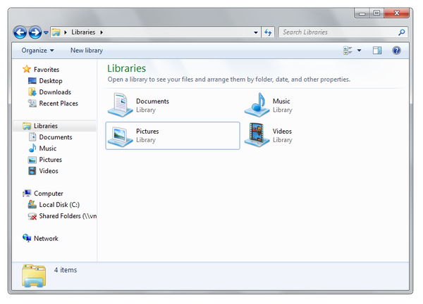
Libraries
Libraries in Windows 7 help you organize
  They make it easier to find, work with, and organize files scattered across your PC or network.
  A library brings your stuff together in one place no matter where it's actually stored.
  Windows 7 comes with libraries for documents, music, pictures, and videos.
  You can also personalize these, or create your own.

Slide 10
BitLocker To Go
BitLocker To Go
  Allows a user to encrypt a USB Drive.
    Protected data incase you loss your device.
  Does not require a TPM (Trust platform module) or special hardware.
  Available only in the Ultimate, and Enterprise editions of Windows 7.
    Other editions can read data, but NOT write.
    Reader software can be used on Windows XP and above.
  Encrypts all data
    It can not be read by 3rd party software.
  Data can be accessed by using a password or smartcard.
  Recovery Key options
  Group Policy options available for enterprise security.

Slide 11
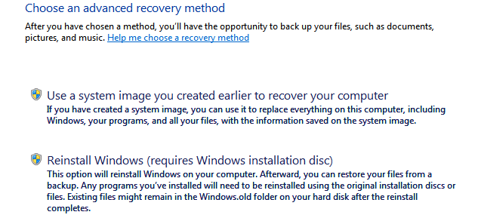
Advanced System Recovery
Advanced System Recovery
  The advanced methods available in Recovery in Control Panel can return Windows to a usable state if it's badly damaged.
    The first method uses a type of backup called a system image, which you need to have created earlier.
    The second method reinstalls Windows, either from a recovery image provided by your computer manufacturer, or from the original Windows installation files.

Slide 12

Polls

Slide 13

Windows 7 for Information Workers
LIVE DEMO

