Slide 1



As today’s cloud-ready information platform, SQL Server 2012 will unlock breakthrough insights as well quickly build solutions and extend data across on-premises and public cloud, backed by mission critical confidence for your organization
Jordan Martz
MCT, MCITP: SharePoint,
SQL Server and SQL Server Business Intelligence Instructor
www.netcomlearning.com

Slide 2

Audience
DB Professionals
  Database professionals who administer and maintain SQL Server database solutions.
  IT Professionals who want to become skilled on SQL Server product features and technologies for implementing a database.
BI Professionals
  Database professionals who need to fulfill a Business Intelligence Developer role.
Core Skills
  Everybody…
www.netcomlearning.com

Slide 3







      DATA EXPLOSION
      CONSUMERIZATION
      OF IT
      PRIVATE AND PUBLIC CLOUD
Hosted
On-premises
Virtualized
Private Cloud
Digital data will grow 44x over the next decade (2009-2020)¹
In 2011, 20% of new databases will be virtualized ²
Public cloud services will account for 46% of net-new growth in IT spending in 2015³
¹IDC Digital Universe Study, sponsored by EMC, May 2010.
²Microsoft internal research
³IDC, Worldwide and Regional Public IT Cloud Services 2011 – 2015 Forecast, Doc #228485, June 2011

Slide 4
New Platform options: managed services
Platform
(Self Managed)
Infrastructure
(as a Service)
Platform
(as a Service)
Software
(as a Service)
Applications
Data
Runtime
Middleware
Database
O/S
Virtualization
Servers
Storage
Networking
Applications
Data
Runtime
Middleware
Database
O/S
Virtualization
Servers
Storage
Networking
Applications
Data
Runtime
Middleware
Database
O/S
Virtualization
Servers
Storage
Networking
Applications
Data
Runtime
Middleware
Database
O/S
Virtualization
Servers
Storage
Networking
Managed Services
Managed Services
Managed Services
www.netcomlearning.com

Slide 5





Data platform requirements
Storage and Search
Comprehensive
Flexible
Global
Federation
Responsive
Available
Secure
Manageable
Composition
Coordination
Transformation
Synchronization
Insight
Monitor
Analyze
Collaborate
Delivery
On premise
Partner-hosted
Microsoft-hosted
Data Programmability
Productive
Interoperable
Supports key standards
On device
Plan
Consolidation
Compliant
Self Managed
PaaS

Slide 6
SQL Release timelines
www.netcomlearning.com

Slide 7
Data platform: sql server 2012
Database Services
SQL Server*
SQL Azure*
Replication
SQL Azure Data Sync*
Full Text & Semantic Search*
Data Integration Services
Integration Services*
StreamInsight*
Project “Austin”*
Analytical Services
Master Data Services*
Data Quality Services*
Reporting Services*
SQL Azure Reporting*
Report Builder
Power View*
Analysis Services*
Data Mining
PowerPivot*
Reporting Services
* New / improved in SQL Server 2012

Slide 8

polls
www.netcomlearning.com

Slide 9
Online Operation Enhancements
Contained Database Authentication
AlwaysOn
Multi-site Clustering
Reliable Secondaries
SQL Server Express LocalDB
Windows Server Core Support
Statistical Semantic Search
PHP & Java Connectivity
FileTable
Unstructured Data Performance
ColumnStore Index
Extended Events Enhancements
Multiple Secondaries
AlwaysOn Connection Director
PowerShell 2.0 Support
Reporting Alerts
Database Recovery Advisor
SQL Server Data Tools
PowerPivot Enhancements
Audit Filtering
T-SQL Debugger Enhancements
Resource Governor Enhancements
Full Globe Spatial
Power View
Flexible Failover Policy
Unstructured Data Performance
BI Semantic Model
Audit Resilience
CDC Support for SSIS
Distributed Replay
New SSIS Design Surface
User-defined Audit
Data Quality Services
SSMS to Windows Azure Platform
FTS Support for Czech and Greek
Master Data Management Excel Add-in
15k Partitions
Full-Text Search Performance
HA for StreamInsight
SSIS Troubleshooting
Availability Groups
Ad Hoc Reporting
Default Scheme for Windows Groups
Spatial 2D Support
ODBC Driver for Linux
SharePoint Active Directory Support
SSIS Package Management
SQL Audit for All Editions
T-SQL Enhancements
Notes:
SQL Server 2012 culminates a multi-year effort and delivers hundreds of valuable capabilities which you have requested, here are some of the most exciting ones. Delivering hundreds of features within a single product release is a great value for customers but what you tell us, and what you’ll see here today, is that there are usually a few key features that will make a major impact to your business and deliver incredible ROI. Let’s take a look at some of the customers already getting great value and seeing ROI on SQL Server 2012.

Slide 10
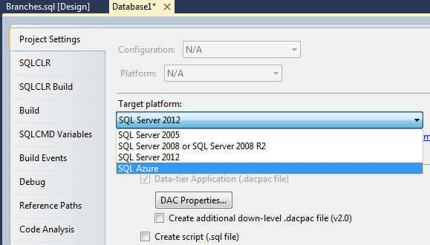
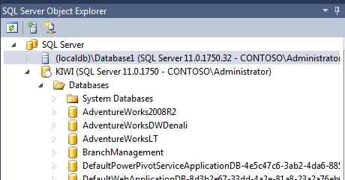
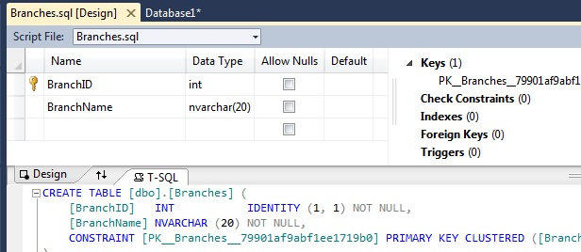
SQL Server Data Tools
Next evolution of Visual Studio based database development tools
  Provides developers with a single tool to support database development needs
  Most developers will not need to install SSMS
  Free availability via Web Platform Installer
  Platform Targeting
www.netcomlearning.com

Slide 11

SQL Server 2012: storage and search
Improved Indexing and Search (Database Engine)
Better Storage Options
Improved database table/index partitioning (15K max partitions)
New statistical semantic search
Improved database FILESTREAM scale and performance
Improved full-text search
Improved database FILESTREAM access via FileTable
Automatic term extraction from content
Discover semantic similarities between documents
SMB support for database / backup files (Windows Server 8 Storage Spaces…)
Increased OLAP string store limit (4 GB)
Database Engine
Analysis Services
New columnstore index technology
Spatial data type improvements
New partitioning and paging support for VertiPaq Engine
New “Tabular Server Mode” adds VertiPaq engine support (same engine as PowerPivot)
New UTF-16 database character encoding support

Slide 12

SQL Server 2012: Federation
New local database runtime support in SQL Server Express
AlwaysOn: readable secondaries (reporting, backups, etc.)
Resource Utilization
Support for multi-site failover clusters
High Availability
DAC support for permissions and role membership
Security
Improved database server roles support customization
Improved database default schema support for groups
New role-based security model
Database Engine
VertiPaq Engine (Analysis Services / PowerPivot)
Database Engine
Support for FILESTREAM
New contained database support eliminates server login dependencies
Improved online operations
Integrated solution across shared and non-shared storage
Support for multiple secondaries
Database Engine (AlwaysOn)
StreamInsight: New checkpoint support
www.netcomlearning.com

Slide 13
SQL Server 2012: Federation
Database Engine: Improved Audit
Governance
New management / diagnostics tools
Manage Efficiently at Scale
DAC Fx: Support for in-place database schema upgrades
Improved SharePoint Integration
Supportability
Integration Services
AlwaysOn: New availability groups support application-centric failover
Database Engine
Reporting Services
Data Quality Services: Support for end user, rule-based data cleansing
New Database Recovery Advisor
Support for extended event tracing and distributed replay
Analysis Services
Sysprep support
Windows Server Core support
Setup support for slipstream upgrade
www.netcomlearning.com

Slide 14

SQL Server 2012: insight and collaboration
Self-Service Reporting, Analytics and Alerting
New PowerPivot release
Improved DAX expression and query language
New Power View thin client in Reporting Services / SharePoint
New support for Data Alerts in Reporting Services / SharePoint
Presentation-ready at all times
Usability improvements
Rich metadata-driven interactivity
Rich Modeling Capabilities
New BI Semantic Model
Model can be cached (VertiPaq) or pass through (DirectQuery)
Support for relational and multidimensional APIs
Unified model for reporting, analytics, scorecards and dashboards
Defined directly within reports
Intuitive Alert rules
Alerts self-managed through SharePoint
Visual, interactive design experience
www.netcomlearning.com

Slide 15

SQL Server 2012: Data programmability
Productive Database Development
Improved Transact-SQL Programmability
Improved deployment and upgrade with Data-tier applications (DAC Fx)
New ANSI-Standard support for sequence generators
Robust metadata discovery
New ANSI-Standard support for results paging (OFFSET / FETCH)
REST access via WCF Data Services and Odata
Improved SQL Server support (Spatial types, stored procedures, table-valued functions)
Improved performance, scale and diagnostics
Code first support
Improved Entity Framework ORM functionality
New THROW statement addresses RAISERROR limitations
Improved SQL Server / SQL Azure parity
Support for more Transact-SQL constructs (e.g. sequence generators, spatial types / indexes)
Support for both schema and data
Service Broker improvements
Improved StreamInsight CEP functionality
www.netcomlearning.com

Slide 16
SQL Server 2012: Data programmability
Interoperability
Enhanced ODBC support for C/C++ Developers (Windows & Linux)
Enhanced JDBC support for Java Developers
New Visual Studio based IDE, available in two different flavors
SQL Server Data Tools (SSDT)
Improved experience for database developers
Declarative, model based development
Integrated tools with modern language services
Work connected and offline with local testing
Platform targeting (SQL Server, SQL Azure…)
Integration Services Designer
Data flow design
Undo / redo
Human readable packages
Enhanced PHP support for PHP Developers
Free Download via Web Platform Installer
Includes Database Engine development tools only
Runs standalone in VS 2010 Shell or integrated with VS 2010 Standard, Pro or Ultimate (but not Express)
With SQL Server 2012
Includes Database Engine stub for online acquisition of database engine development tools.
Runs standalone in VS 2010 Shell or integrated with VS 2010 Standard, Pro or Ultimate (but not Express)
Formerly known as Business Intelligence Development Studio
Also includes BI Development tools (RS, AS, IS)
www.netcomlearning.com

Slide 17














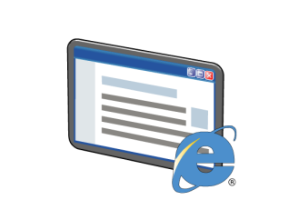

SQL Server As a Data Warehousing Platform
Microsoft SQL Azure
and the Windows Azure Marketplace
Microsoft SQL Server Integration Services
Data Warehousing

SQL Server Database Engine
1011000110
SQL Server Master Data Services
SQL Server Data Quality Services
SQL Server
Analysis Services
SQL Server
Reporting Services
Microsoft PowerPivot Technologies
Business Intelligence
Interactive data analysis
Microsoft Excel
Data Mining Add-In
PowerPivot Add-In
MDS Add-In
Interactive data visualizations
Power View
Microsoft SharePoint Server
Reports, KPIs, and Dashboards
Notes:
Point out that the top part of the diagram shows the technologies that will be examined in this course (Course 10777A, Implementing a Data Warehouse with Microsoft® SQL Server® 2012).
To learn about the technologies in the bottom section of the diagram, students should attend Course 10778A, Implementing Data Models and Reports with Microsoft® SQL Server® 2012.

Slide 18







Components of a Data Warehousing Solution
Reporting and Analysis
Data Cleansing
1011000110
Data Sources
ETL Staging Process
ETL Load Process
Landing Database
Staging Database
Data Warehouse
An ETL process extracts data from business applications and other sources
Data is typically staged before being loaded into the data warehouse
Data cleansing and deduplication ensures the quality of data in the data warehouse
Master data management provides definitive data for business entities

Master Data Management
Notes:
Note that not all data warehousing solutions include all of the components that are shown on the slide. However, each component has an important part to play in the implementation of a data warehousing solution and will be considered in this course.

Slide 19

INTRODUCTION
SQL SERVER ENTERPRISE INFORMATION MANAGEMENT
Integration Services
Master Data Services
Data Quality Services
Primarily designed to implement ETL processes
Provides a robust, flexible, fast, scalable and extensible architecture
Master data management
Manages reliable, centralized data
Broadens its reach with a new Excel Add-in that can leverage Data Quality Services
Knowledge-driven data cleansing
Corrects, de-duplicates and standardizes data
Integrates with Integration Services
Complete, Current, Consistent and Clean Data
www.netcomlearning.com

Slide 20

Extract, Transform, and Load Processes
Staging:
  What data must be staged?
  Staging data format
Required transformations:
  Transformations during extraction versus data flow transformations
Incremental ETL:
  Identifying data changes for extraction
  Inserting or updating when loading
www.netcomlearning.com
Notes:
Point out the note in the student workbook and remind students that incremental extract, transform, and load (ETL) is covered in more depth in Module 7, “Implementing an Incremental ETL Process.”

Slide 21
Data Quality and Master Data Management
Data quality:
  Cleansing data:
    Validating data values
    Ensuring data consistency
    Identifying missing values
  Deduplicating data
1011000110
Master data management:
  Ensuring consistent business entity definitions across multiple systems
  Applying business rules to ensure data validity

www.netcomlearning.com
Notes:
Point out the note in the student workbook and remind students that SQL Server Data Quality Services and SQL Server Master Data Services are covered in more depth later in the course.

Slide 22




SQL SErVER 2012 Data Quality Services
DQS PROCESS
Cloud Services
Build
Knowledge
Management
Reference
Data
Discover / Explore Data / Connect
Knowledge
Manage
Enterprise
Data
Status
Progress
Notifications
Integrated
Profiling
Use
Correct
& Standardize
Match & De-duplicate
Data Quality Projects
www.netcomlearning.com

Slide 23
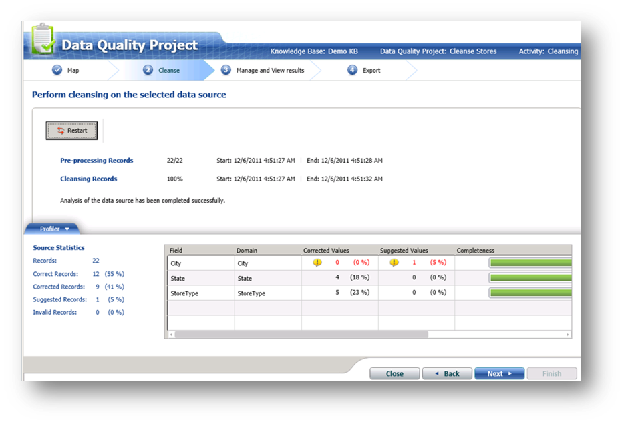
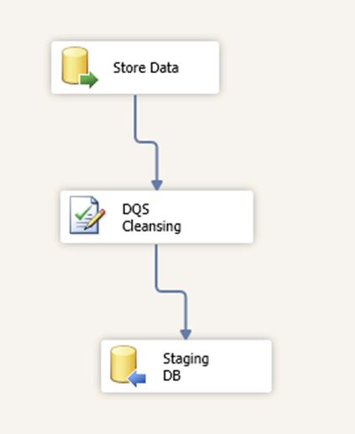
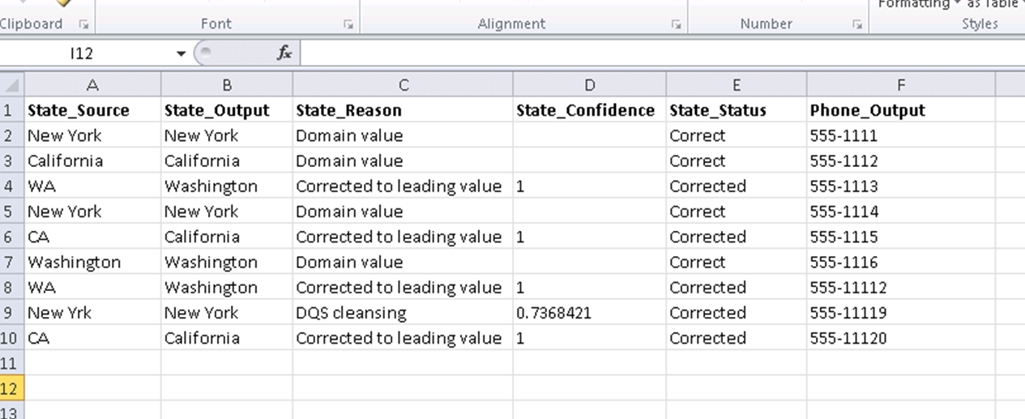
Data Cleansing Projects
Process of Cleansing

Slide 24
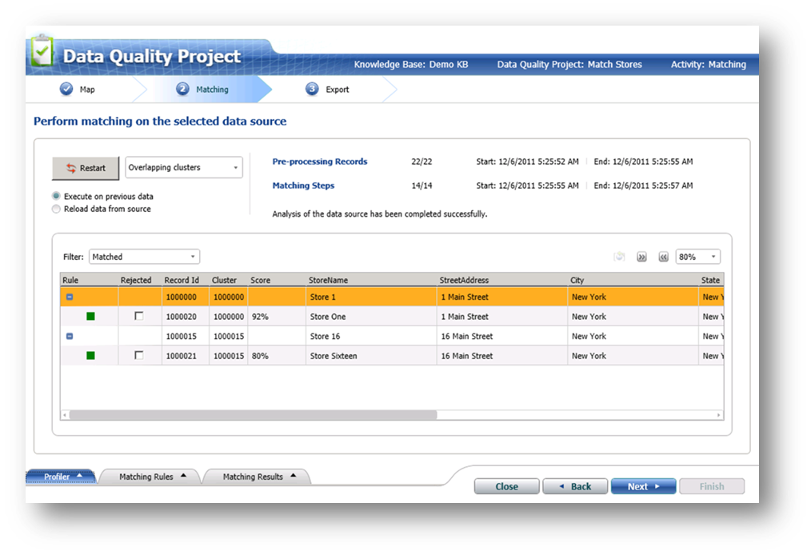
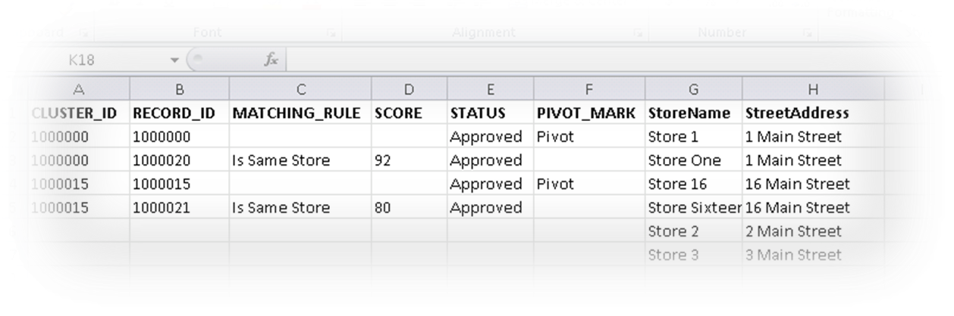
Data Quality SerVices
Process of Matching Data
www.netcomlearning.com

Slide 25
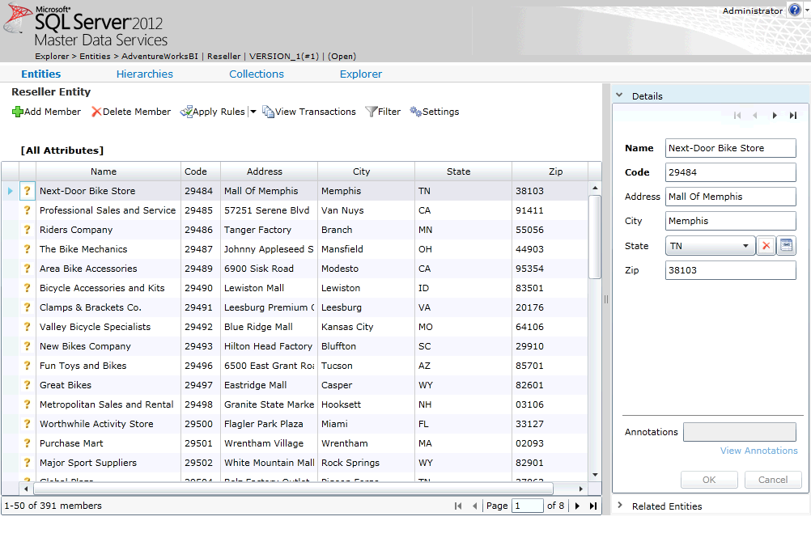
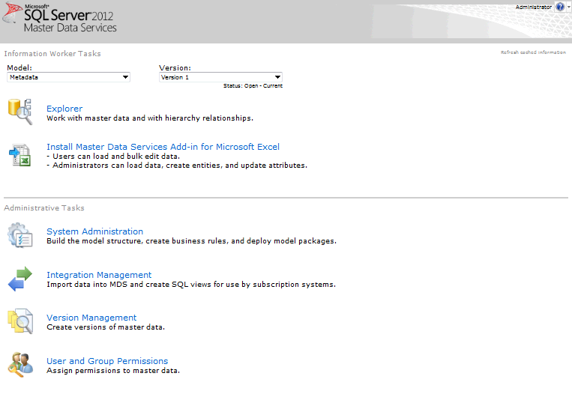
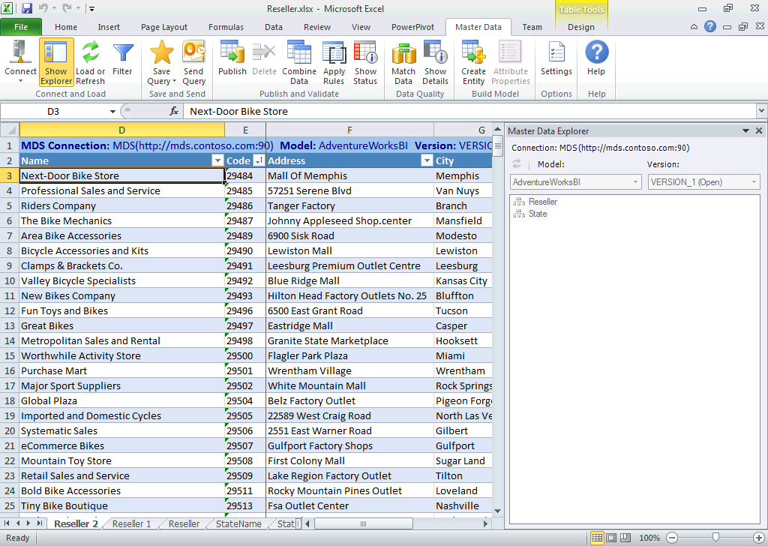
SQL Server 2012
Master Data Services
The next-generation master data management solution delivered in SQL Server 2012

Slide 26




The Need for Master Data Management
CRM
Customer ID | Name | Address | Phone
1235 | Ben Smith | 1 High St, Seattle | 555 12345
?
Order Processing System
Marketing System
Account No | Customer | Address | Phone
531 | Benjamin Smith | 1 High St, Seattle | 555 12345
Contact No | Name | Address | Phone
22 | B Smith | 5 Main St, Seattle | 555 54321
www.netcomlearning.com

Slide 27

What Is Master Data Services?
CRM
Customer ID | Name | Address | Phone
1235 | Ben Smith | 1 High St, Seattle | 555 12345

Master Data Hub
Customer ID | Account No | Contact No | Customer | Address | Phone
1235 | 531 | 22 | Ben Smith | 1 High St, Seattle | 555 12345
Master Data Services
Data Steward
Other consumers
(e.g. Data Warehouse ETL)
Order Processing System
Marketing System
Account No | Customer | Address | Phone
531 | Benjamin Smith | 1 High St, Seattle | 555 12345
Contact No | Name | Address | Phone
22 | B Smith | 5 Main St, Seattle | 555 54321
www.netcomlearning.com

Slide 28
Master Data Models
A versioned data model for specific business item or area of the business
Contains definitions for entities required in the business area
  Often an entity with the same name as the model, as well as related entities
Each entity has a defined set of attributes
  All entities have Code and Name attributes
  Attributes can be categorized in attribute groups
Each instance of an entity is a known as a member
Customers Model
Version 1
Account Type Entity
Member
Attributes:
Code (string)
Name (string)
Code: 1
Name: Standard
Member
Code: 2
Name: Premier
Customer Entity
Member
Attributes:
Code (free-form text)
Name (free-form text)
Address (free-form text)
Phone (free-form text)
AccountType (domain-based)
CreditLimit (free-form number)
Code: 1235
Name: Ben Smith
Address: 1 High St, Seattle
Phone: 555-12345
AccountType: 1
CreditLimit: 1000
Contact Details Attribute Group
Version 2
Version 3
Notes:
40007A
3: Enterprise Integration Management and Data Warehousing

Slide 29

Implementing a Master Data Hub
CRM
Master Data Hub
Other consumers
(e.g. Data Warehouse ETL)
SSIS
SSIS

SSIS
SSIS
Order Processing System
Data Steward
Marketing System
Users insert and update data in application data stores
Application data is loaded into the master data hub via staging tables for consolidation and management by data stewards
Master data flows back to application data stores and other consumers across the enterprise via subscription views
Notes:
40007A
3: Enterprise Integration Management and Data Warehousing

Slide 30

      Breakthrough Insight
      Customers Want
      SQL Server 2012 Delivers
Rapid data exploration
PowerPivot built on Excel and Power View for stunning data visualizations & broad adoption
Managed self-service BI
End user agility through self-service BI balanced with enterprise security & governance via SharePoint
Credible, consistent data
Data Quality Services & BI Semantic Model for increased productivity and data accuracy, built-in
Scalable analytics & DW
Proven analytics for 24+TB¹ cubes, and 15K partitions delivering Tier 1 scalability for large sliding windows
¹Microsoft Evidence: Yahoo
30
Notes:
Breakthrough Insight
With SQL Server 2012, customers can quickly plow through volumes of data with rapid data exploration and discovery. Power View is a new self-service analytics tool providing stunning interactive data visualizations. This release also includes enhancements to PowerPivot, which is built on Excel and enables broad end user adoption.
Via SharePoint, you can enable self-service BI, balanced with enterprise security and governance.
Features such as Data Quality Services and the new BI Semantic Model deliver increased productivity and data accuracy with built-in tools.
Finally, customers can get up to 15K partitions, helping to deliver Tier 1 scalability for large sliding windows in ERP applications such as SAP.

Slide 31


      Breakthrough Insight
      Real-world value delivered, today
Interactive data visualizations
NEW Power View
EdgeNet connects Manufacturers, Retailers & Shopping Engines to create world-class-product data feeds where quickly slicing and visualizing data is critical to providing the highest quality products and services.
Driving greater sales through increased analysis
Increased speed of ad-hoc analysis and productivity of IWs
Expanded BI access and use, reduced tax on DBAs
“Power View has allowed spur of the moment questions to be answered by users who previously did not have the expertise to find the answers.”
31
Notes:
EdgeNet connects Manufacturers, Retailers and Shopping Engines to create world-class-product data feeds. In EdgeNet’s business, quickly slicing and visualizing data is critical to providing the highest quality products and services. With the business intelligence capabilities of SQL Server 2012, the company was able to drive greater sales through increased analysis—and to increase the speed of ad-hoc analysis. By expanding BI access and use, EdgeNet also saw a reduced burden on the company’s DBAs. With Power View and its interactive data visualizations, the company reports that end-users are able to answer questions that they previously did not have the expertise to answer on their own.

Slide 32
SQL Server BI and
Sharepoint 2010 Integration
Goal: Make SQL Server the preferred choice for managing unstructured data with rich application support
  80% of all data is stored outside of databases
  Most data is "unstructured"
SQL Server 2008 down-payments
  Efficient storage of BLOB data
  FILESTREAM storage
  Remote BLOB store
SQL Server 2012 contributions
  Scale (100+ million documents)
  FILETABLE (support top apps that produce/consume
  unstructured data without app change)
  Full-text enhancements
  Statistical semantic search
www.netcomlearning.com

Slide 33



Scalable Insight with BI Semantic Model
Single, model for BI applications to provide a consistent view of data
BI Semantic Model
  Enables a wide spectrum of capabilities – from dashboards and scorecards to reports and analytics.
  Enhance productivity with design aids and best practices.
  New Tabular mode:
  Enable faster iteration and reduce complexity in design.
  In-memory column store technology
CAPABILITIES
CLIENT TOOLS
Analysis, Reports, Scorecards, Dashboards, Custom Apps
BI SEMANTIC MODEL
  Data model
  Business logic and queries
  Data access
DATA SOURCES
Databases, LOB Applications, Odata Feeds, Spreadsheets, Text Files
www.netcomlearning.com

Slide 34

How Should I Build My Model?
Depends on the application needs for each layer
  Model, Logic, Storage
Two Visual Studio (BIDS) project types in SQL 2012
  Multidimensional project – with MDX and MOLAP/ROLAP
  Tabular project – with DAX and VertiPaq/DirectQuery
Project types could change after SQL 2012
  VertiPaq in multidimensional projects, MDX scripts in tabular projects…
  Based on customer feedback
blogs.technet.com/b/dataplatforminsider/archive/2010/11/12/analysis-services-roadmap-for-sql-server-denali-and-beyond.aspx

Slide 35
POWERVIEW
Abstraction Layer
Faster to develop solutions and easier to maintain
Hybrid Model – Power of OLAP with a relational view
Familiar Excel like language (DAX)
Shorter learning curve
Excellent choice for departmental solutions
Address Issues of PowerPivot Marts
Benefits
 | Multi-dimensional | Tabular
Actions | Yes | No
Aggregations | Yes | Yes
Calculated Measures | Yes | Yes
Custom Assemblies | Yes | No
Custom Rollups | Yes | No
Distinct Count | Yes | Yes (via DAX)
Drill-through | Yes | No
Hierarchies | Yes | Yes
KPIs | Yes | Yes
Linked objects | Yes | No
Many-to-many | Yes | No
Parent-child Hierarchies | Yes | Yes (via DAX)
Partitions | Yes | Yes
Perspectives | Yes | Yes
Semi-additive Measures | Yes | Yes
Translations | Yes | No
User-defined Hierarchies | Yes | Yes
Write-back | Yes | No

Slide 36
Data Access and Storage
VertiPaq
  In-memory column store… typical 10x compression
  Brute force memory scans… high performance by default… no tuning required
  Basic paging support… data volume mostly limited to physical memory
MOLAP
  Disk based store… typical 3x compression
  Disk scans with in-memory subcube caching… aggregation tuning required
  Extensive paging support… data volumes can scale to multiple terabytes
DirectQuery
  Passes through DAX queries & calculations… fully exploits backend database capabilities
  No support for MDX queries… no support for data sources other than SQL Server (in Denali)
ROLAP
  Passes through fact table requests… not recommended for large dimension tables
  Supports most relational data sources… no support for aggregations except SQL Server indexed views
www.netcomlearning.com

Slide 37


















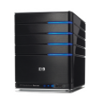
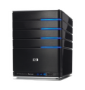









SQL Server 2012 Analysis Services
Use cases
Power
View
Third-Party
Applications
Reporting
Services
Excel
PowerPivot
SharePoint
Insights
DAX Query
MDX Query
Personal BI
Team BI
Corporate BI
BI Semantic Model
PowerPivot for Excel
PowerPivot for SharePoint
Analysis Services
Project Type
PowerPivot Workbook
Tabular Project
Multidimensional Project
Design Type
Tabular
Tabular
Multidimensional
Development Tool
One Model for All End User Experiences
Excel 2010
SQL Server Data Tools
SQL Server Data Tools
Business Logic
DAX
DAX
MDX
Data Access – Cache
Passthrough
In-Memory
N/A
In-Memory
DirectQuery
MOLAP
ROLAP
Deployment
A PowerPivot workbook can be restored to a Tabular instance, or imported to create a Tabular Project
SharePoint Library /
Analysis Services
PowerPivot
Analysis Services
Tabular
Analysis Services
Multidimensional
Relational
Databases
LOB
Applications
Files
OData
Feeds
Cloud
Services
Deployed
BI Semantic Model
37

Slide 38
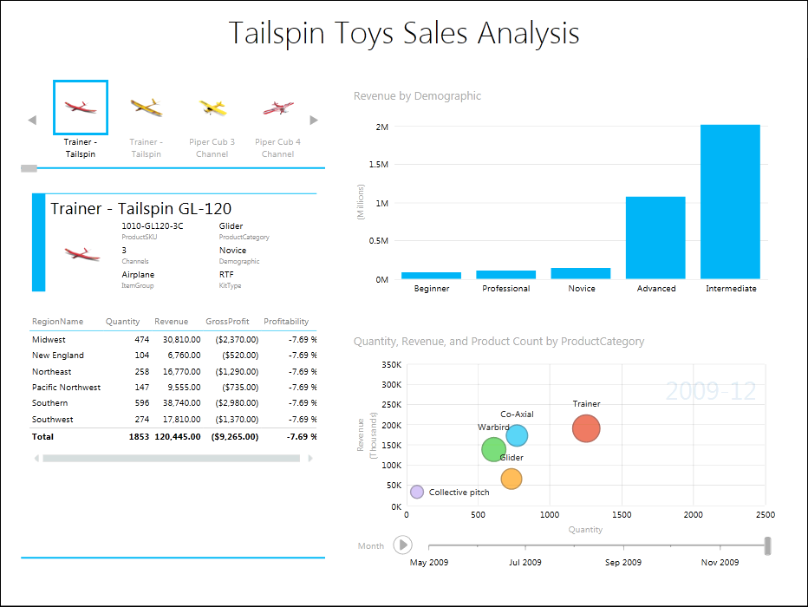
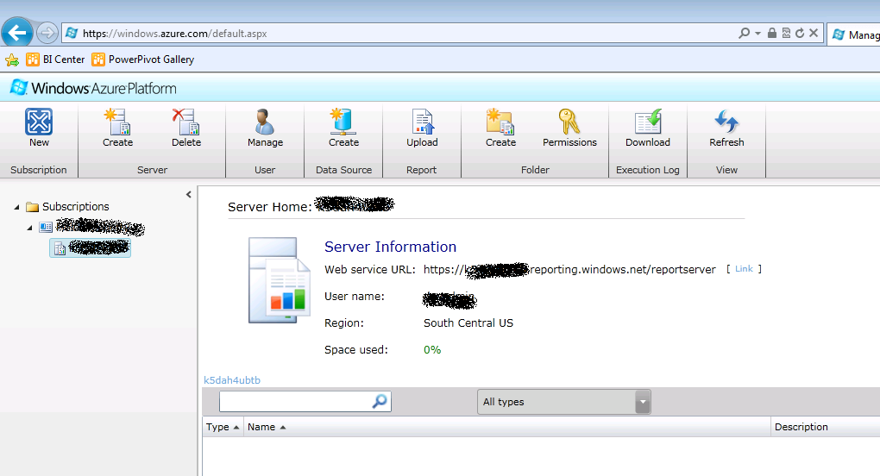
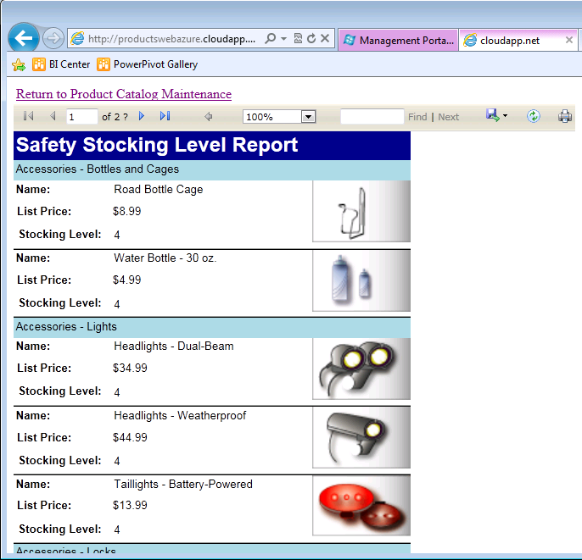
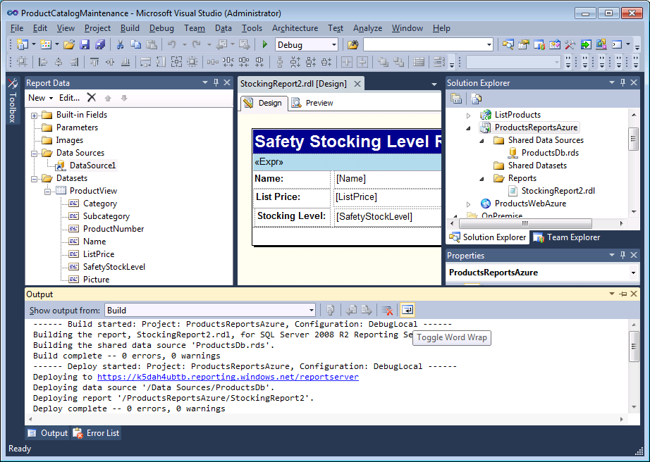
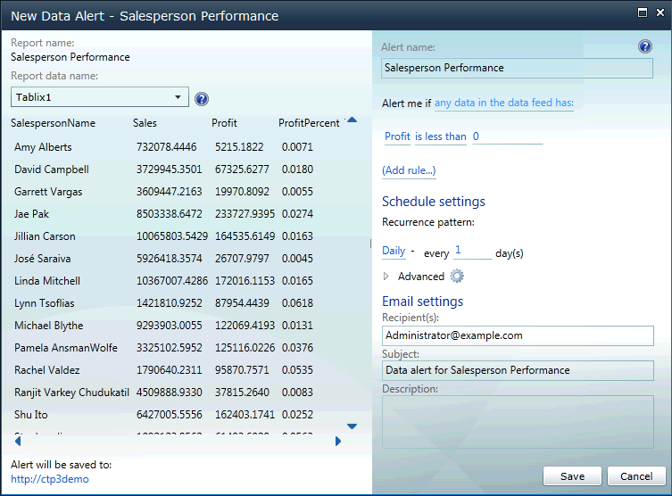
SQL SERVER 2012 Reporting SERVICES
POWER VIEW
Use Cases
Visualizations:
Matrices
Charts
Cards
Tiles
Scatter charts
SQL AZURE REPORTING
DATA ALERTS

Slide 39








Demo: Managed Self Service BI - PowerPivot for SharePoint
BI Development Studio
Browser
SharePoint
Excel Services
Analysis Services
BI Semantic Model
xlsx
Reporting Services
PowerPivot for
Excel
PowerPivot for SharePoint
(Analysis Services)
Excel
xlsx
Third Party Apps
Personal BI Team BI Organizational BI
www.netcomlearning.com

Slide 40

      Cloud On Your Terms
      Customers Want
      SQL Server 2012 Delivers
  Scale on demand
  Easily move applications across on-premises and cloud with unlimited virtualization and license mobility
  Fast time to market
  Enable Hybrid IT to offer flexibility and choice across on-premises and cloud
  Optimized productivity
  Common management & development tools: SQL Server Data Tools, T-SQL & SSMS
  Extend any data, anywhere
  Extend to cloud with Windows Azure Marketplace and Data Sync; Support for unstructured data & interop with PHP & Java
Notes:
Cloud On Your Terms
SQL Server 2012 helps you to migrate to the cloud on your terms, with the flexibility to quickly create, extend and scale solutions that solve challenges and fuel new business opportunity across on-premises and public cloud. Through a common architecture, License Mobility, and unlimited virtualization, you can easily move applications across on-premises and cloud—and extend applications to the cloud with SQL Azure. Hybrid IT environments are supported with common management and development tools for faster time-to-market and increased productivity.

Slide 41

start with the basics
SQL Azure Database is
  SQL Server database technology delivered as a service on the Windows Azure Platform
  Ideal for both simple and complex applications
  Enterprise-ready with automatic support for HA
  Designed to scale out elastically with demand
Get started quickly
  Choose a plan
  Choose a billing option
  Provision servers
Ready to get started?
  Let’s jump into development
www.netcomlearning.com

Slide 42
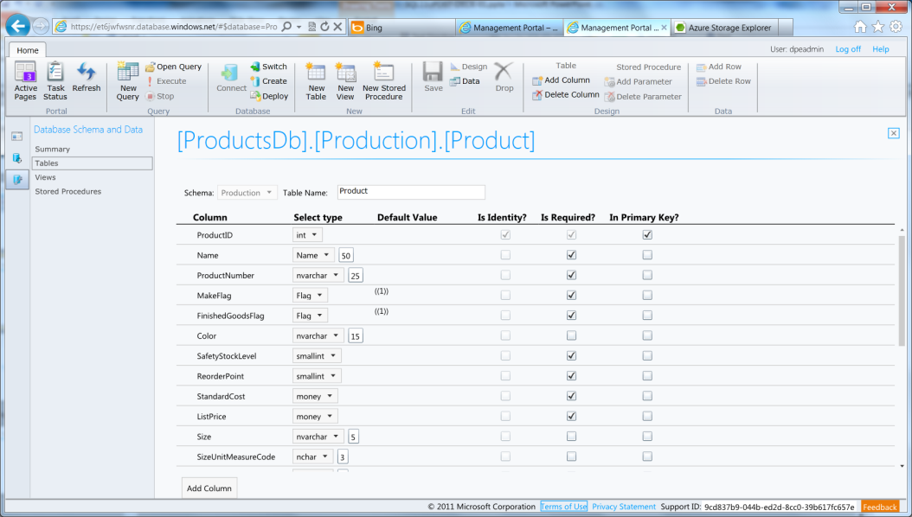
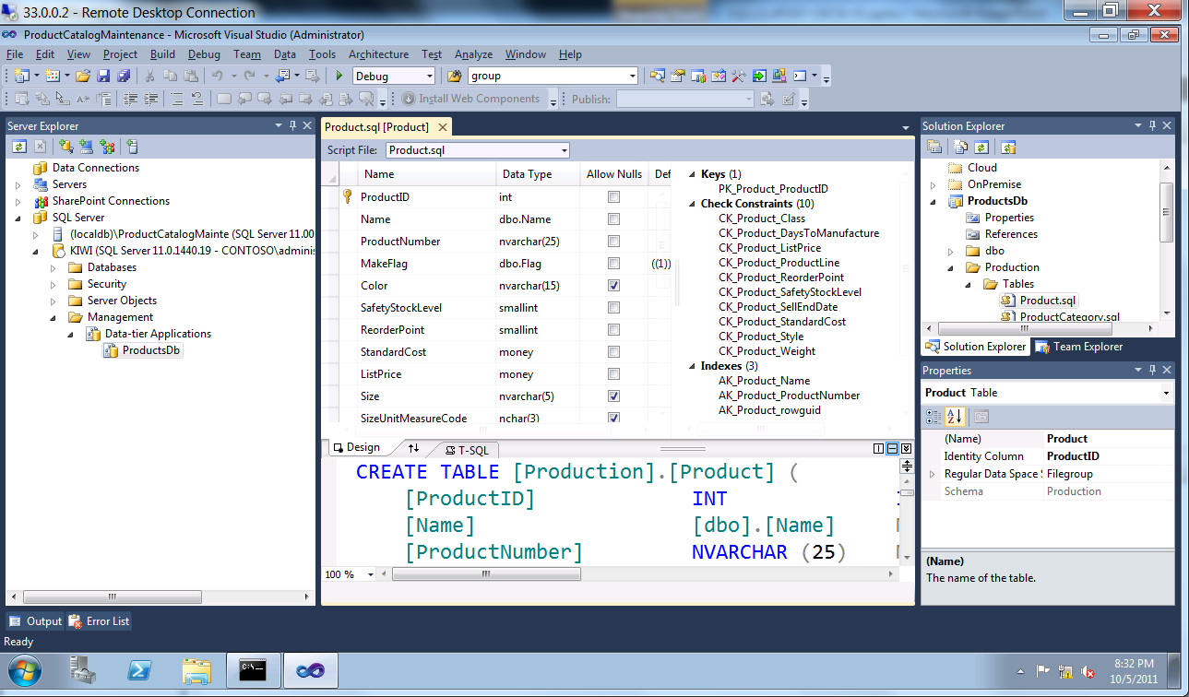
build your database
Thin client database development
  Introducing the SQL Azure management portal
  Web designers for tables, views, stored procs
  Interactive query editing and execution
Rich client database development
  Introducing SQL Server Data Tools (SSDT)
  Visual Studio IDE for database development
  Includes modern designers and projects with declarative, model-driven development
  Develop and test in both connected and disconnected states
  Platform targeting for both SQL Server (2005 and above) and SQL Azure
  Get it free with Web PI, with SQL Server 2012 and with Visual Studio 11
www.netcomlearning.com

Slide 43
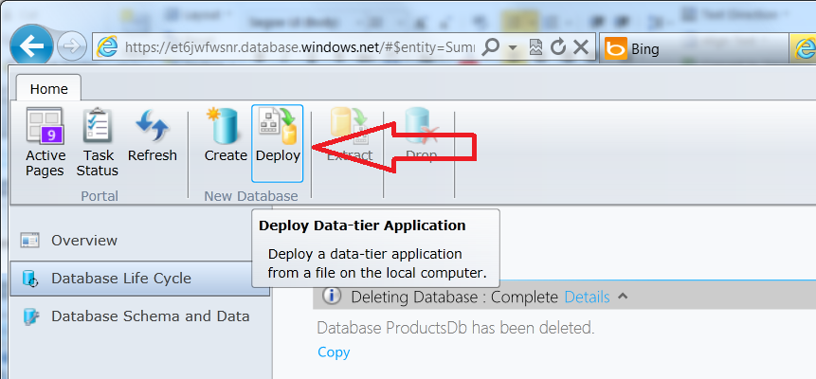
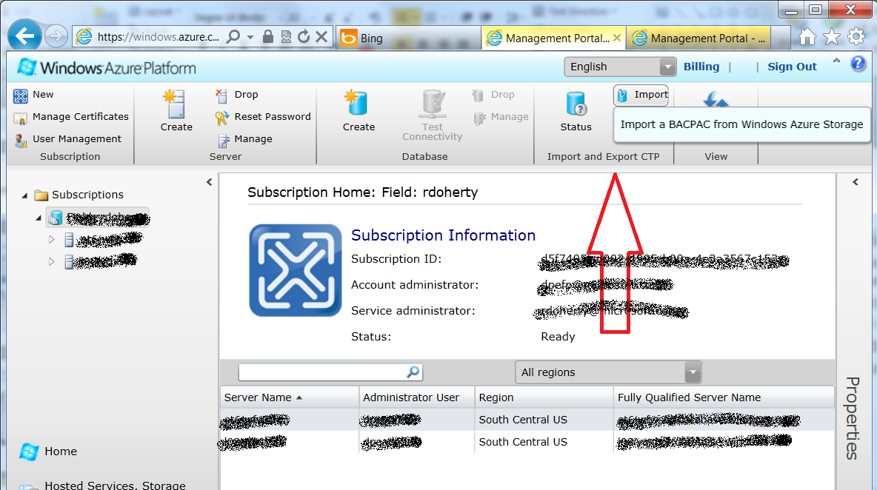
deploy your database
Interactive approach for dacpac v1 and v2
  Manage your server with SQL Azure Management Portal
  Deploy dacpac
  Load data (scripts, bulk copy, SSIS)
  Also supported in SQL Server 2012 Management Studio
Interactive approach for bacpac v2
  Upload bacpac to blob storage
  Log into Windows Azure Management Portal
  Import bacpac, table data automatically loaded
  Also supports export to blob storage
Upgrading a dacpac or bacpac
  Not supported in portals yet
  Use SQL Server 2012 Management Studio
www.netcomlearning.com

Slide 44
connect your application
Connecting to SQL Azure
  TDS (Tabular Data Stream) protocol over TCP/IP supported
  SSL required
  Use firewall rules to connect from outside Microsoft data center
  ASP.NET example:
Special considerations
  Legacy tools and providers may require special format for login: [login]@[server]
  Idle connections terminated after 30 minutes
  Long running transactions terminated after 24 hours
  DoS guard terminates suspect connections with no error message
  Failover events terminate connections
  Throttling may cause errors
  Use connection pooling and implement retry logic to handle transient failures
  Latency introduced for updates due to HA replicas
  No cross-database dependencies, result sets from different databases must be combined in application tier
<connectionStrings>
<addname="AdventureWorks"connectionString=
"Data Source=[server].database.windows.net;
Integrated Security=False;
Initial Catalog=ProductsDb;
User Id=[login];
Password=[password];
Encrypt=true;"
providerName="System.Data.SqlClient"/>
</connectionStrings>
www.netcomlearning.com

Slide 45


      Cloud On Your Terms
      Real-world value delivered, today
NEW Hybrid IT scenarios
Common Architecture & Tools
Miami’s 911 system ran on a mainframe. Today when someone dials 911 in Miami, emergency personnel are dispatched from the system’s Windows Server. Data from the system is stored in a SQL Server database.
911 system on premise, 311 in cloud to scale for major incidents, saving the city an estimated $900,000 a year
Modernized & extended applications to new areas, not previously possible
“The cloud is absolutely the future, and Microsoft has made it easy to migrate mainframe applications”
Notes:
When the City of Miami wanted to update their mainframe-based 911 system, they opted for a Microsoft solution for its ability to make it easier to migrate mainframe applications to a hybrid environment—including on-premises and cloud. Now, when someone dials 911 in Miami, emergency personnel are dispatched from the system’s Windows Server, and data from the system is stored in a SQL Server database. The City was able to house the 911 system on premise, while the 311 system resides in the cloud to scale for major incidents, saving an estimated $900,000 per year. The City was also able to modernize and extend applications to new areas, which was not possible with the previous system.

Slide 46
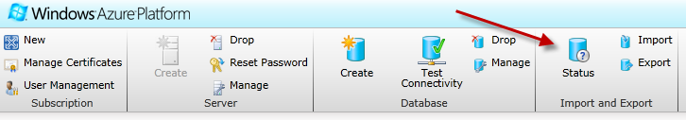
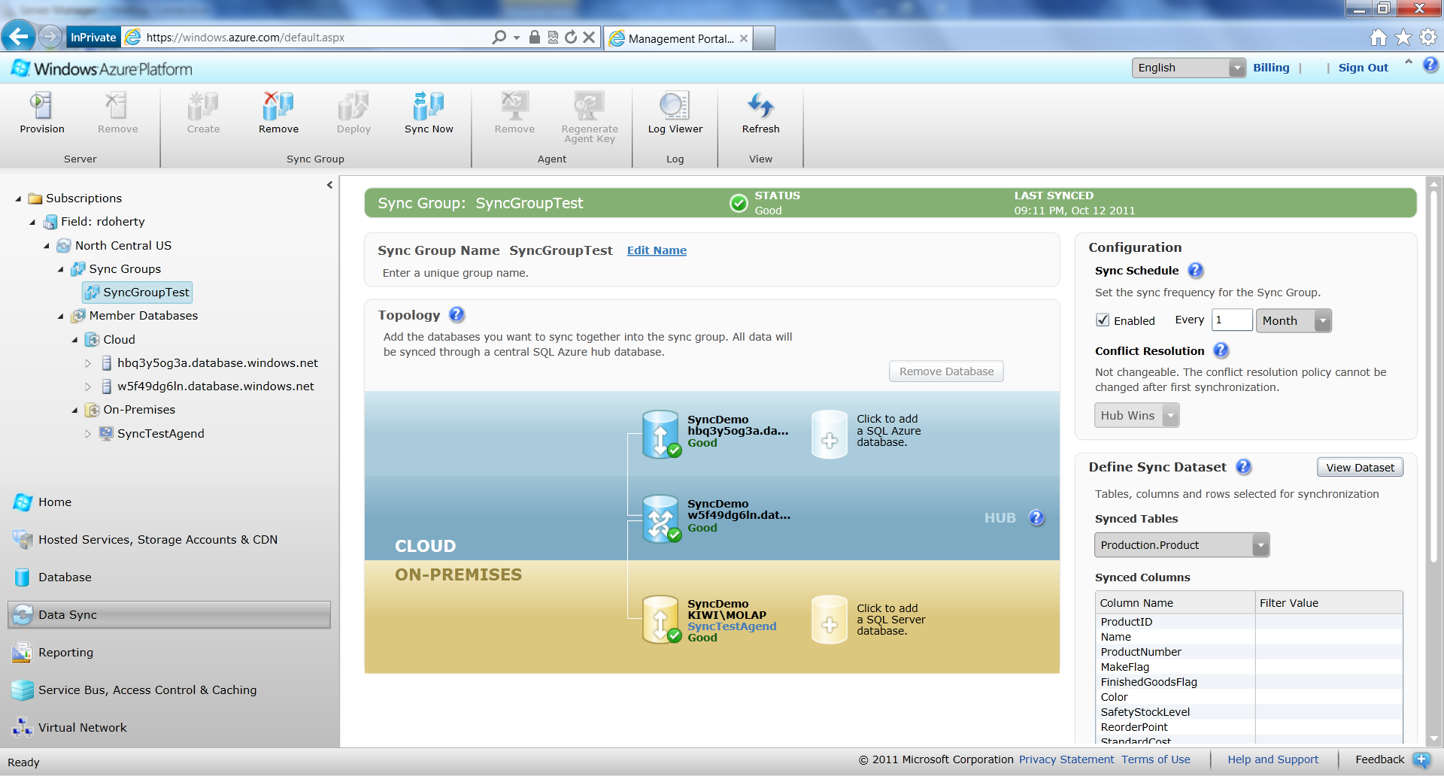
Scale on Demand - Cloud Elastic

Slide 47
Extend Data Anywhere
- Azure Data Sync
synchronize your data
SQL Azure Data Sync is
  Microsoft Sync Framework technology delivered as a service on the Windows Azure Platform
  Ideal for scheduling synchronization between data sets hosted in SQL Azure or SQL Server
  Uses a hub and spoke topology
Special considerations
  Conflict resolution policy configured centrally (hub or client wins)
  Sync direction configured between each client and the hub (to hub, from hub, bi-directional)
  Sync schedule must be between 5 minutes and 1 month
  Data sets include multiple tables and can be filtered, triggers are added to data set tables
  Tables added to hub and client schemas
  Agent must be installed for on-prem clients
SQL Azure (Hub)
SQL Azure (US)
SQL Azure (WE)
SQL Server (OnPrem)
www.netcomlearning.com

Slide 48
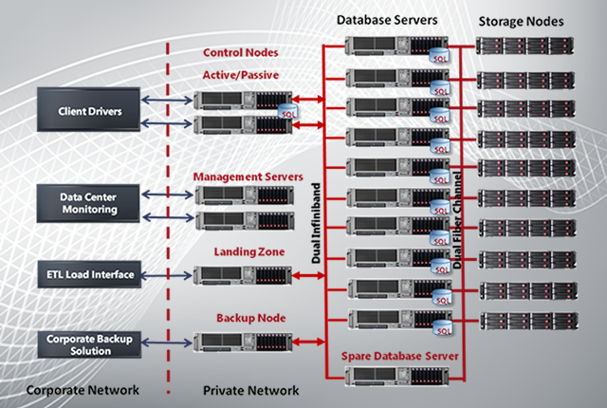
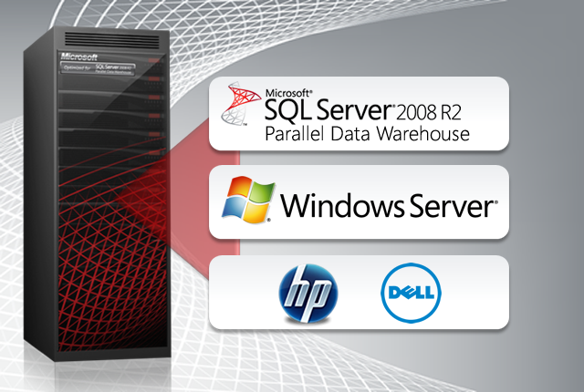
Scalable Analytics and DW – PDW
Parallel Data Warehouse
Organizations need actionable and timely business insights from rapidly growing data. Take advantage of Microsoft SQL Server Parallel Data Warehouse and its massively parallel processing (MPP) architecture to gain scalable performance, flexibility, and hardware choices with the most comprehensive data warehouse solution available.

Slide 49
Microsoft Learning
Data Warehousing and Business Intelligence
Course 10777A: Implementing a Data Warehouse with Microsoft® SQL Server® 2012
Course 10778A: Implementing Data Models and Reports with Microsoft® SQL Server® 2012
Exam number | Exam Title
70-463 | Implementing a Data Warehouse with Microsoft® SQL Server® 2012
www.netcomlearning.com

Slide 50
Microsoft Learning Program
First Look Clinic 40007A: Microsoft® SQL Server® 2012
Database Professional
10774A: Querying Microsoft® SQL Server® 2012
10775A: Administering Microsoft® SQL Server® 2012 Databases
10776A: Developing Microsoft® SQL Server® 2012 Databases
Business Intelligence Professional
10777A: Implementing a Data Warehouse with Microsoft® SQL Server® 2012
10778A: Implementing Data Models and Reports with Microsoft® SQL Server® 2012
Existing SQL Server Professional
40008A: Updating your Database Skills to Microsoft® SQL Server® 2012
40009A: Updating your Business Intelligence Skills to Microsoft® SQL Server® 2012
www.netcomlearning.com
Notes:
Explain the Microsoft Learning program and present the list of additional recommended courses.
Refer students to the Microsoft Learning Web page at
http://www.microsoft.com/learning/ for information about curriculum paths

Slide 51
Microsoft Certification Program
Exam | Exam Title
70-461 | Querying Microsoft® SQL Server® 2012
70-462 | Administering Microsoft SQL Server 2012 Databases
70-463 | Implementing a Data Warehouse with Microsoft SQL Server 2012
70-464 | Developing Microsoft SQL Server 2012 Databases
70-465 | Designing Database Solutions for Microsoft SQL Server 2012
70-466 | Implementing Data Models and Reports with Microsoft SQL Server 2012
70-467 | Designing Business Intelligence Solutions with Microsoft SQL Server 2012
www.netcomlearning.com
Notes:
Inform students about the Microsoft Certified Professional (MCP) program, any certification exams that are related to this course, and the various certification options.

Slide 52
10774A: Writing Queries Using Microsoft® SQL Server® 2012 Transact-SQL
Module 11: Use Set Operators
Module 12: Using Window Ranking, Offset and Aggregate Functions
Module 13: Pivoting and Grouping Sets
Module 14: Writing Specialized Queries
Module 15: Executing Stored Procedures
Module 16: Programming with T-SQL
Module 17: Implementing Error Handling
Module 18: Implementing Transactions
Module 19: Querying SQL Server Metadata
Module 20: Improving Query Performance
Module 1: Introduction to SQL Server 2012
Module 2: Introduction to Transact SQL Querying
Module 3: Writing SELECT Statements
Module 4: Combining Data from Multiple Tables
Module 5: Filtering and Sorting Data
Module 6: Working with SQL Server Data Types
Module 7: Using Built-In Functions
Module 8: Grouping and Aggregating Data
Module 9: Using Subqueries
Module 10: Using Table Expressions
www.netcomlearning.com

Slide 53
10775A: Course 10775A: Maintaining a Microsoft® SQL Server® 2012 Database
Module 11: Authorizing Users to Access Resources
Module 12: Auditing SQL Server Environments
Module 13: Automating SQL Server 2012 Management
Module 14: Configuring Security for SQL Server Agent
Module 15: Monitoring SQL Server 2012 with Alerts and Notifications
Module 16: Performing Ongoing Database Maintenance
Module 17: Tracing Access to SQL Server 2012
Module 18: Monitoring SQL Server 2012
Module 19: Managing Multiple Servers
Module 20: Troubleshooting Common SQL Server 2012 Administrative Issues
Module 1: Introduction to SQL Server 2012 and its Toolset
Module 2: Preparing Systems for SQL Server 2012
Module 3: Installing and Configuring SQL Server 2012
Module 4: Working with Databases
Module 5: Understanding SQL Server 2012 Recovery Models
Module 6: Backup of SQL Server 2012 Databases
Module 7: Restoring SQL Server 2012 Databases
Module 8: Importing and Exporting Data
Module 9: Authenticating and Authorizing Users
Module 10: Assigning Server and Database Roles
www.netcomlearning.com

Slide 54
10776: Implementing a Microsoft SQL Server 2012 Database
Module 13: Creating Highly Concurrent SQL Server 2012 Applications
Module 14: Handling Errors in T-SQL Code
Module 15: Responding to Data Manipulation via Triggers
Module 16: Implementing Managed Code in SQL Server 2012
Module 17: Storing XML Data in SQL Server 2012
Module 18: Querying XML Data in SQL Server 2012
Module 19: Working with SQL Server 2012 Spatial Data
Module 20: Working with Full-Text Indexes and Queries
Module 1: Introduction to SQL Server 2012 and its Toolset
Module 2: Working with Data Types
Module 3: Designing and Implementing Tables
Module 4: Ensuring Data Integrity through Constraints
Module 5: Planning for SQL Server 2012 Indexing
Module 6: Implementing Table Structures in SQL Server 2012
Module 7: Reading SQL Server 2012 Execution Plans
Module 8: Improving Performance through Non-Clustered Indexes
Module 9: Designing and Implementing Views
Module 10: Designing and Implementing Stored Procedures
Module 11: Merging Data and Passing Tables
Module 12: Designing and Implementing User-Defined Functions
www.netcomlearning.com

Slide 55
10777A: Implementing a Data Warehouse with Microsoft SQL Server 2012
Module 1: Introduction to Data Warehouse Concepts
Module 2: Data Warehouse Hardware Considerations
Module 3: Designing and Implementing a Data Warehouse
Module 4: Creating an ETL Solution with SSIS
Module 5: Implementing Control Flow in an SSIS Package
Module 6: Debugging and Troubleshooting SSIS Packages
Module 7: Implementing an Incremental ETL Process
Module 8: Incorporating Data from the Cloud in a Data Warehouse
Module 9: Enforcing Data Quality
Module 10: Using Master Data Services
Module 11: Extending SSIS
Module 12: Deploying and Configuring SSIS Packages
Module 13: Consuming Data in a Data Warehouse
www.netcomlearning.com

Slide 56
10778A: Implementing Reports and Data Models with Microsoft SQL Server 2012
Module 1: Overview of Reporting and Data Modeling
Module 2: Implementing Reports with Reporting Services
Module 3: Supporting Self-Service Reporting
Module 4: Managing a Reporting Infrastructure
Module 5: Creating Multidimensional Databases
Module 6: Working with Cubes and Dimensions
Module 7: Working with Measures and Measure Groups
Module 8: Introduction to MDX
Module 9: Customizing Cube Functionality
Module 10: Implementing a PowerPivot for Excel Workbook
Module 11: Introduction to Data Analysis Expression (DAX)
Module 12: Implementing a Tabular Database
Module 13: Creating Data Visualizations With Crescent
Module 14: Performing Predictive Analysis with Data Mining
www.netcomlearning.com

Slide 57
Resources
SQL Server 2012 Information and Downloads
  microsoft.com/sqlserver
www.netcomlearning.com

Slide 58
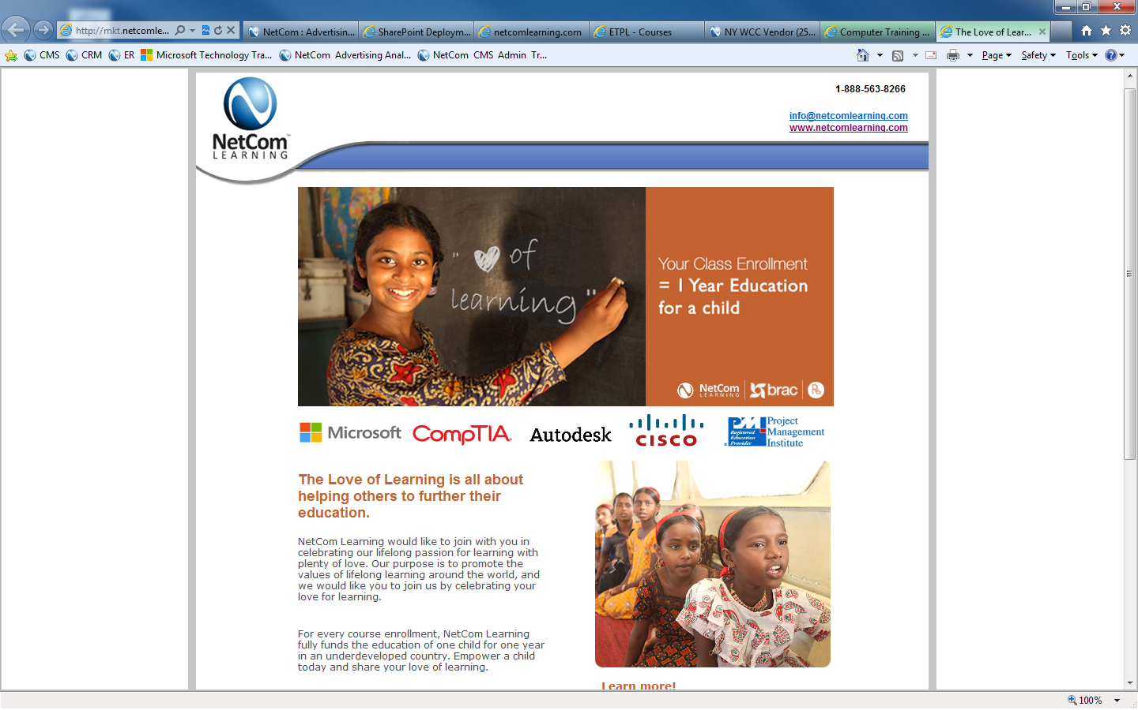
Love of Learning
Empowering The Disadvantaged
Your class enrollment at NetCom Learning will pay for a child’s education for a year!
Enroll and Empower!

Slide 59
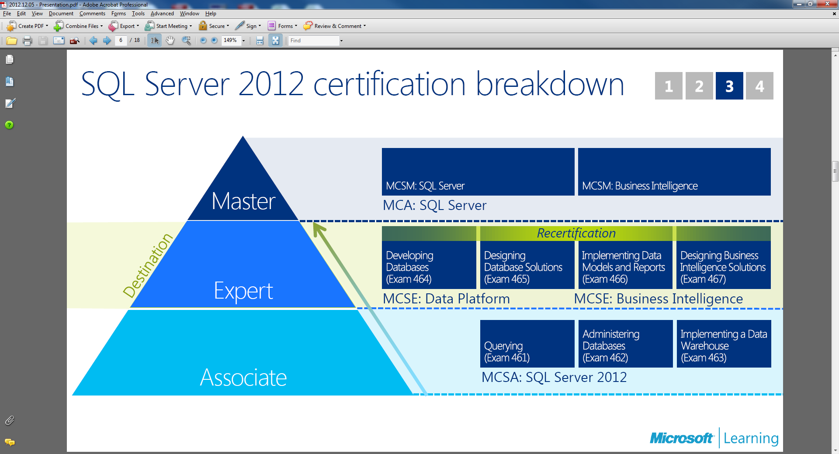
*Free Second Shot Exam expires May 31st, 2013

Slide 60
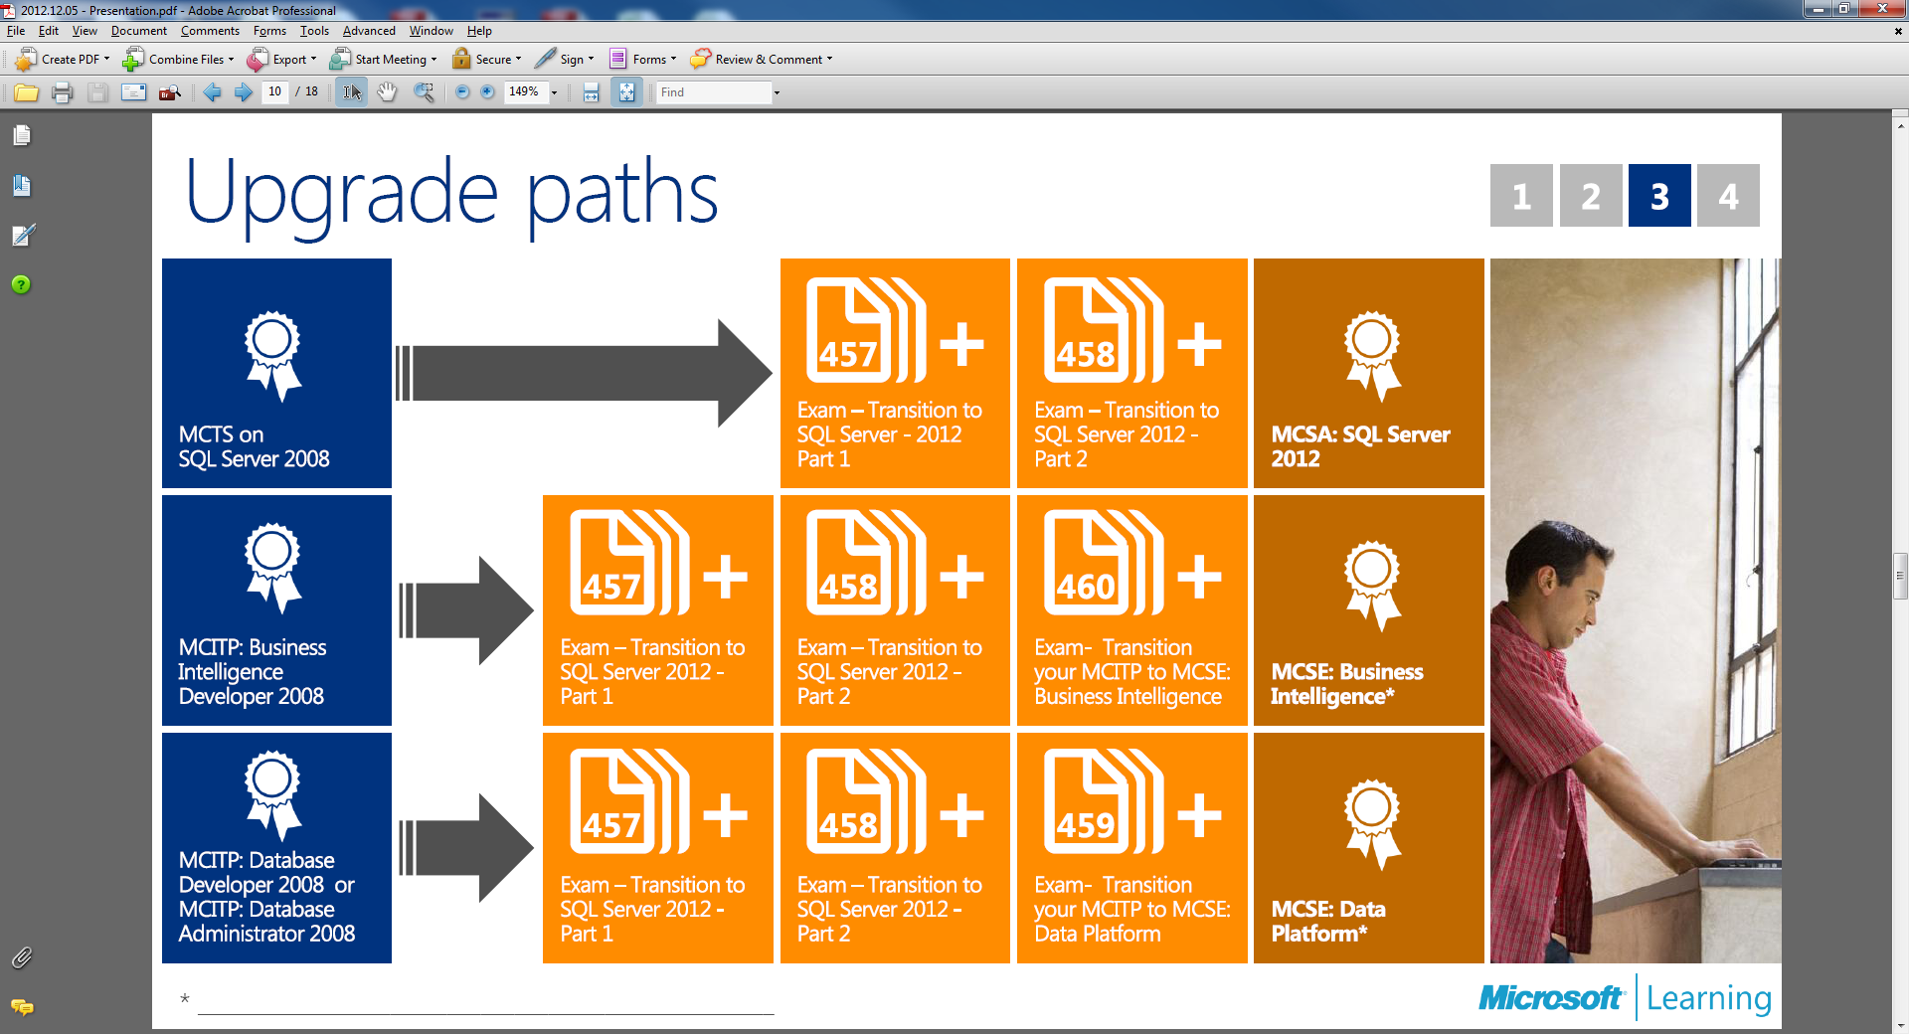
Upgrade Paths

Slide 61



Upcoming SQL Server 2012
Classes
MCSA: SQL Server 2012 (120 Hours)
  March 4th in NYC & Live Online (GTR)
MCSA: SQL Server 2012 Boot Camp (120 Hours)
  April 8th in DC Metro Area & Live Online (GTR)
  April 29th in Las Vegas & Live Online (All Inclusive Learning Package)
MCSE: Business Intelligence (80 hours)
  April 1st in New York City & Live Online (GTR)
MCSE: Data Platform (80 Hours)
  April 22nd in New York City & Live Online (GTR)
Locations:
Attend in-class or Live Online Instructor-led
  New York
  Las Vegas (All Inclusive Learning Package)
  Arlington VA
  Philadelphia, PA

Slide 62
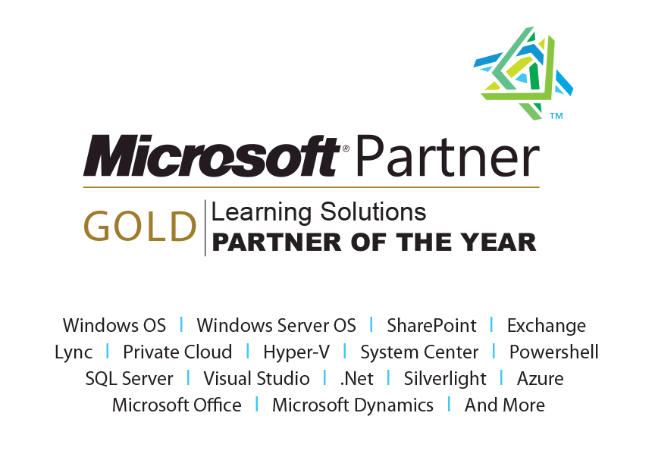


Q & A
1-888-5-NETCOM (563-8266)
info@netcomlearning.com
www.NetComLearning.com
Notes:
2:00 pm

