Slide 1



Lync Server 2013 Part 1
Features and Functionality
Richard Oertle
Subject Matter Expert
www.NetComLearning.com

Slide 2

What is improved from Lync 2010
Lync now supports IP6
Lync has a connector to Skype (limited to IM, voice)
Lync Attendee is replaced with Lync fully featured web client
Video resolution is now H.264 (1080p) for all video
All roles can be virtualized
Roles can be co-located
Group Chat is now a Chat room with tabbed conversations
Contacts fully integrated into Active Directory and Exchange (Unified Contact Store)
Increased PBX functionality
Full Integration with Office 365 for a Cloud/Hybrid solution
Notes:
40029
01: Introduction to the New Microsoft Lync Features and Functionality

Slide 3
Module Overview
Communicate and Connect
Video and Voice
Collaboration and Meetings
Availability Across Multiple Devices
Virtual Desktop Infrastructure (VDI) Plug-in
Notes:
40029
01: Introduction to the New Microsoft Lync Features and Functionality

Slide 4
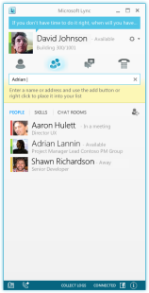
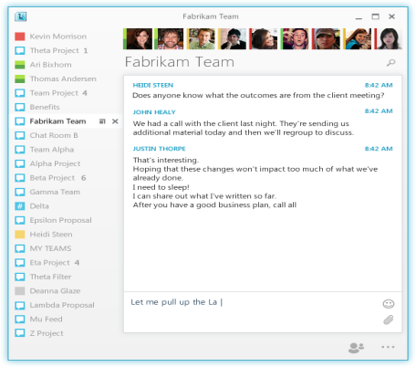
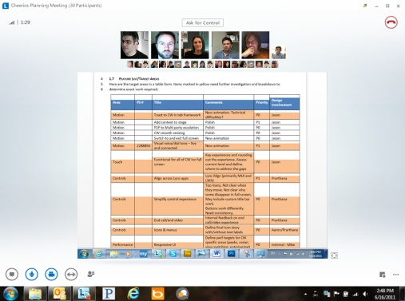
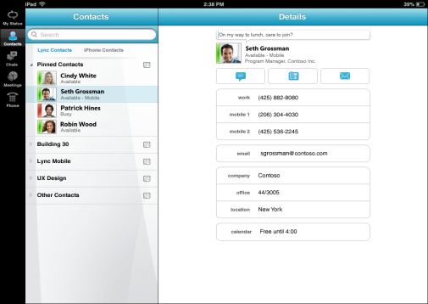

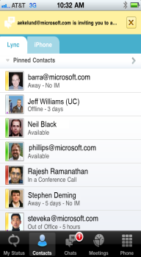
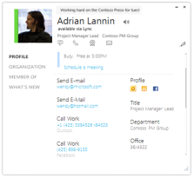

What’s New in Lync Client
Communicating and connecting in Lync
Collaborating using voice and video in Lync
Lync is available virtually anytime, anywhere on almost any device
Find, connect, and communicate with Microsoft Office users
Connect and communicate with external users
Manage Lync IM & presence and persistent chat features
Lifelike video experience with multi-view video and higher resolutions
Web conferencing
Voice conferencing
Office integration
Lync is available on a variety of mobile devices
Lync is available on the web
Lync is available on room systems
Lync as a Hosted Service
Notes:
40029
01: Introduction to the New Microsoft Lync Features and Functionality

Slide 5
Lesson 1: Communicate and Connect
One Experience Across Computers, the Web, Your Devices, and Your Phone
Connect Anywhere in Office
Lync Main Window
Contacts View
Contact Card
Persistent Chat Rooms
Instant Messaging and Presence
The Conversation Window
Notes:
40029
01: Introduction to the New Microsoft Lync Features and Functionality

Slide 6


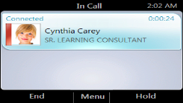
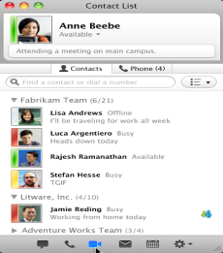
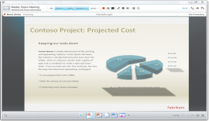
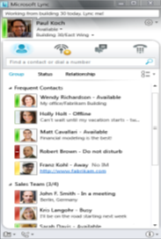
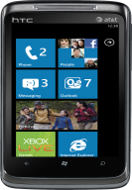
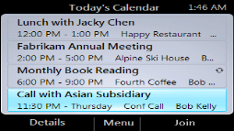


One Experience Across Computers, the Web, Your Devices, and Your Phone
Mac
PC
Browser
Mobile
Desk Phones
Notes:
Use the slide to emphasize the single experience users can have across all of their devices. Include reference to the bullet points in the topic content.
40029
01: Introduction to the New Microsoft Lync Features and Functionality

Slide 7
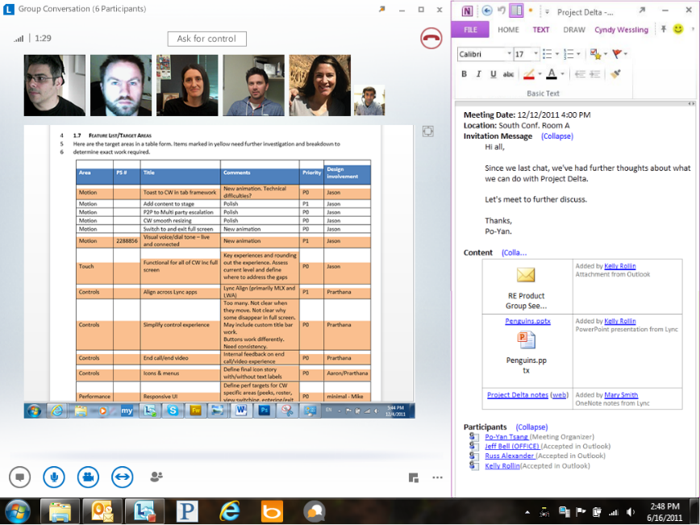
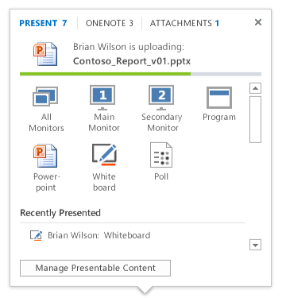
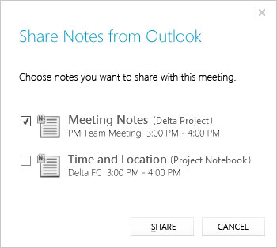
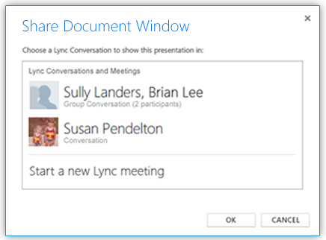
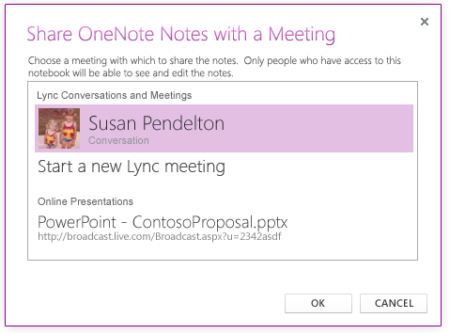
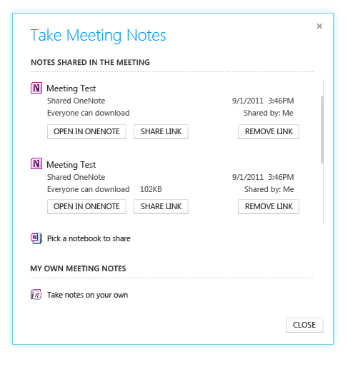
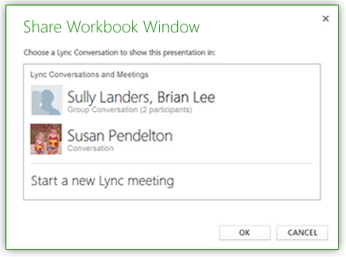
Connect Anywhere in Office
Easily share Office documents in a Lync meeting
OneNote enables new ways to collaborate before, during, and after meetings
Tech notes:
  PowerPoint (PPT) sharing relies on the new Office Web Application Server integration
  OneNote permissions are not managed by Lync
Notes:
This is an important new feature of Lync. Talk about the new features listed in the topic content as well as what they give you as shown on the slide. Stress the easier and streamlined communications experience.
40029
01: Introduction to the New Microsoft Lync Features and Functionality

Slide 8
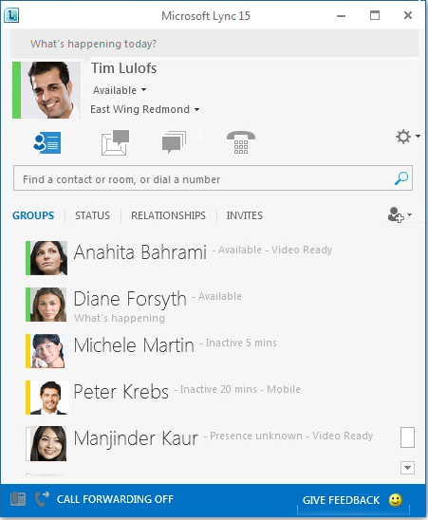
Lync Main Window
A new Chat Rooms icon replaces the Activity Feeds icon on the main Lync page. With the Chat Rooms icon, you can quickly access your chat rooms and filters
A new Full Screen icon lets you expand your Lync window to fill the screen
A new Add a contact button helps you quickly build your Contacts list
Notes:
Give a quick demonstration of the new features, look, and feel of the Lync main window.
40029
01: Introduction to the New Microsoft Lync Features and Functionality

Slide 9
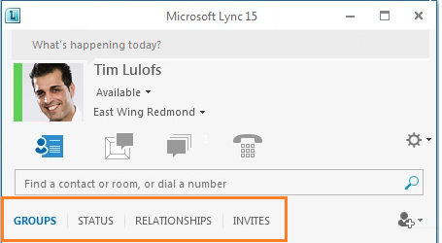
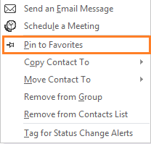
Contacts View
Notes:
40029
01: Introduction to the New Microsoft Lync Features and Functionality

Slide 10
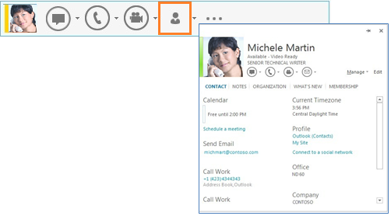
Contact Card
Notes:
40029
01: Introduction to the New Microsoft Lync Features and Functionality

Slide 11
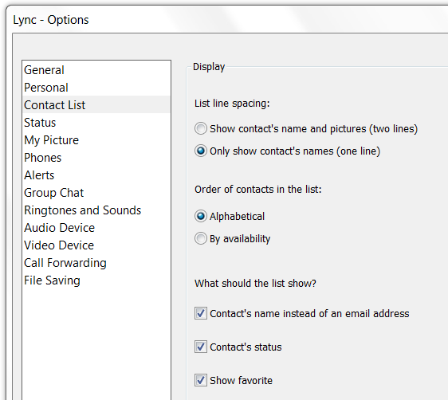
Contact List Options
Notes:
Speak about the new Contact List option settings available in Lync - Options.
40029
01: Introduction to the New Microsoft Lync Features and Functionality

Slide 12
Representing People in Lync - Consistent Experience
Lync Align
Develop a shared approach and framework that balances the need and/or desire for a unified Lync experience with the expectations and constraints of specific platforms
The end result is a clear point of view on the user experience (UX) language for our ecosystem
User Benefits:
I know it is Lync
I know what to expect in every Lync client – it is simply the best place to communicate, share, and interact
I want to use Lync on all my devices
Lync takes advantage of my device capabilities
Interactions are appropriate for my device
I can move between devices easily
Notes:
40029
01: Introduction to the New Microsoft Lync Features and Functionality

Slide 13
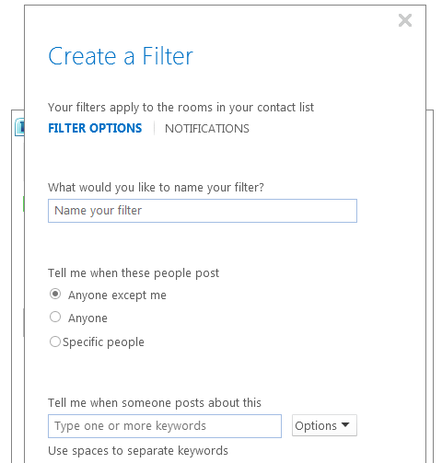
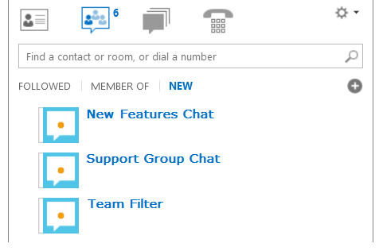
Persistent Chat Rooms
Notes:
40029
01: Introduction to the New Microsoft Lync Features and Functionality

Slide 14
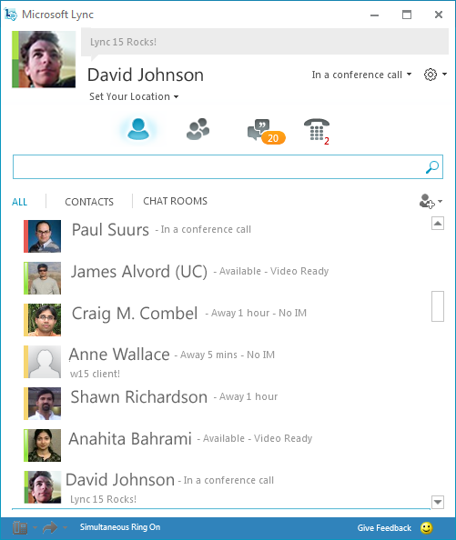
Instant Messaging and Presence
Representing People in Lync – Aggregated Presence
People in the contact list are also aggregated
  Default presence/IM is determined by search
  Adding by URI = pinned to that URI
    Adding “djohnson@hotmail.com” to contacts will pin presence to djohnson@hotmail.com
  Adding by Name = pinned to GAL URI
    Adding “David Johnson” to contacts will pin presence to djohnson@microsoft.com
Notes:
40029
01: Introduction to the New Microsoft Lync Features and Functionality

Slide 15
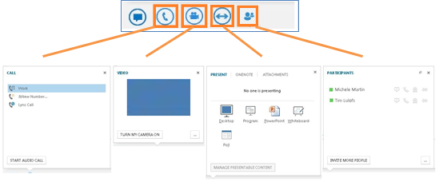
The Conversation Window
Notes:
Discuss and give a quick demo of each of the Conversation Window icons highlighted in this slide.
40029
01: Introduction to the New Microsoft Lync Features and Functionality

Slide 16
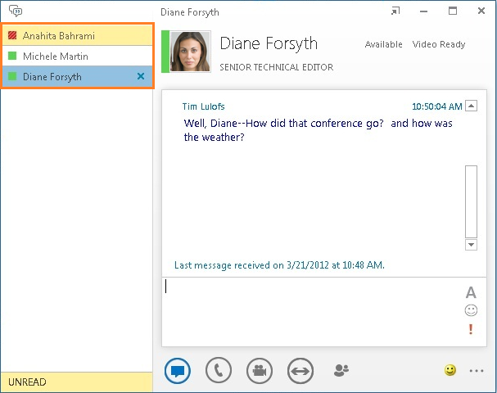
New Tabbed Conversations Feature
Notes:
Talk about the advantages and ease of use of the pop-in and pop-out buttons to break in and out of conversations. Also, the tabbed conversation feature makes it easy to keep track of calls, IMs, and chat rooms all in one window.
40029
01: Introduction to the New Microsoft Lync Features and Functionality

Slide 17

Polls

Slide 18
Lesson 2: Video and Voice
Lifelike Video Experience
Enhancements in Multi-View Video
Notes:
40029
01: Introduction to the New Microsoft Lync Features and Functionality

Slide 19
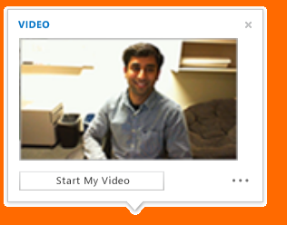
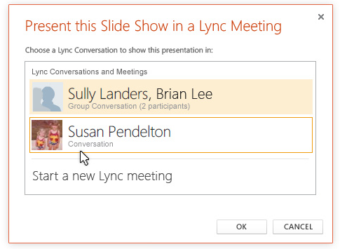


Lifelike Video Experience
Innovate in video collaboration
Integrate more closely with Office experiences
Modernize Lync user experience
Extend the reach of Lync to the web, thin clients, phones, slates, individuals, and education
Notes:
Emphasize the exciting new innovations in Lync for collaborating with video in meetings as well as during interactions among multiple people. This is an opportunity to highlight ways in which you can be innovative in various scenarios. Ask students to think of ways they would use video with Lync.
40029
01: Introduction to the New Microsoft Lync Features and Functionality

Slide 20
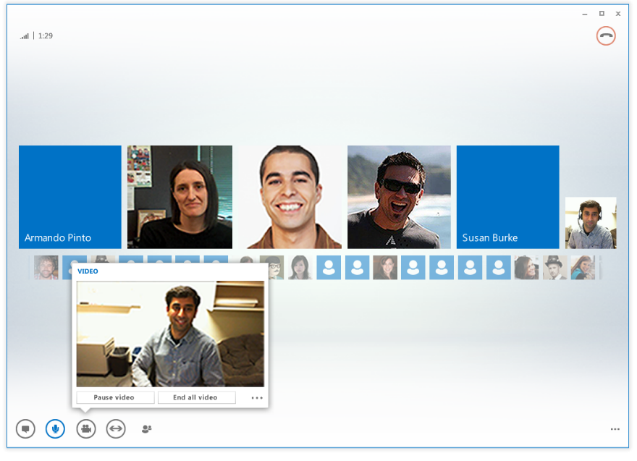
Enhancements in Multi-View Video
“Immersive and meaningful video makes me feel like I’m there.”
I can quickly initiate immersive communication with multiple people
I know who is talking
I see how others see me
Tech notes:
  High-resolution photos come from Exchange
  Target is ~0.5MP (648x648); smaller photos will be scaled
Notes:
40029
01: Introduction to the New Microsoft Lync Features and Functionality

Slide 21
Lesson 3: Collaboration and Meetings
Office Web App Server
Lync Web App
Audio Conferencing, Room Systems
Notes:
40029
01: Introduction to the New Microsoft Lync Features and Functionality

Slide 22
Office Web App Server
Using the new Web Application Companion-based Office Presentation Service, present your PowerPoint presentation in a Lync meeting
  Advance through slides and animations or bring up thumbnails for quick navigation
  Annotate and telepoint on the presentation
  View speaker notes as you present
  Adjust meeting options to control whether meeting participants can navigate through slides on their own or annotate presentations
Synchronously play embedded multimedia files in PowerPoint decks (New in Lync!)
  Support for Windows Media Video (WMV), H.264, and non-native content (e.g., You Tube Video) up to 20 megabytes (MBs)
  Meeting participants are automatically muted during video playback
  Presenter can play, stop, and seek to a specific location
  Multimedia will not be recorded at full fidelity
Integrates seamlessly with Lync 2010 clients
Notes:
If attendees are permitted, they can view the video privately like any other slide.
Users will be prompted to install Microsoft Silverlight® or Flash if not already installed.
The new look and feel to the presentation, thumbnails, and notes experience are aligned with Office 365.
40029
01: Introduction to the New Microsoft Lync Features and Functionality

Slide 23
Lync Web App
Operating system | 32-bit Version of Internet Explorer 10 | 64-bit Version of Internet Explorer 10 | 32-bit Version of Internet Explorer 9 | 64-bit Version of Internet Explorer 9 | 32-bit Version of Internet Explorer 8 | 64-bit Version of Internet Explorer 8 | 32-bit Version of Firefox 10.X | 64-bit Version of Safari 5.X | 32-bit Version of Chrome 17.x
Windows 7 with SP1 | Yes | Yes | Yes | Yes | Yes | Yes | Yes | No | Yes
Windows Vista with Service Pack 2 (SP2) | Yes | No | Yes | No | Yes | No | Yes | No | Yes
Windows XP with Service Pack 3 (SP3) | N/A | N/A | N/A | N/A | Yes | No | Yes | No | Yes
Windows Server 2008 R2 with SP1¹ | Yes | Yes | Yes | Yes | Yes | Yes | Yes | No | Yes
Windows Server 2008 with SP2² | Yes | No | Yes | No | Yes | No | Yes | No | Yes
Mac OS-x (Intel-based) ¹ | N/A | N/A | N/A | N/A | N/A | N/A | Yes | Yes | Yes
Notes:
Briefly go over the expanded browser support for LWA.
40029
01: Introduction to the New Microsoft Lync Features and Functionality

Slide 24
Audio Conferencing, Room Systems
Lync audio conference enhancements:
Mute the audience and allow or block video sharing
Use meeting room audio controls to mute, unmute, and change device
Upload presentations with video clips and display using easy video controls
As a presenter, allow or block sending videos
Merge conversations while in a meeting
Save meeting recordings automatically
Share meeting notes with anyone or to a shared location
Notes:
Mention the following to the students:
The first time you join a Lync meeting or conference call, the Join Meeting Audio dialog box appears. You can then join the meeting with full audio and video conference capabilities. After you log in to the meeting, you can use the meeting audio controls to mute, unmute, change audio device, and so on. The first time you join a Lync meeting or conference call, the Join Meeting Audio dialog box appears. You can then join the meeting with full audio and video conference capabilities. After you log in to the meeting, you can use the meeting audio controls to mute, unmute, change audio device, and so on.
40029
01: Introduction to the New Microsoft Lync Features and Functionality

Slide 25





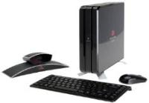
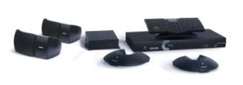




Lync Video and Meeting Solutions
Meeting room devices
Notes:
Use this slide to emphasize the range of Lync video and meeting solutions across a wide variety of devices.
40029
01: Introduction to the New Microsoft Lync Features and Functionality

Slide 26
Lesson 4: Availability Across Multiple Devices
Mobile Devices
Web Conferencing Tools
Conferencing and Hosted Service
Notes:
40029
01: Introduction to the New Microsoft Lync Features and Functionality

Slide 27

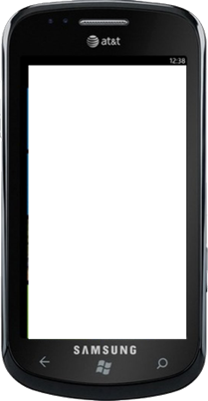

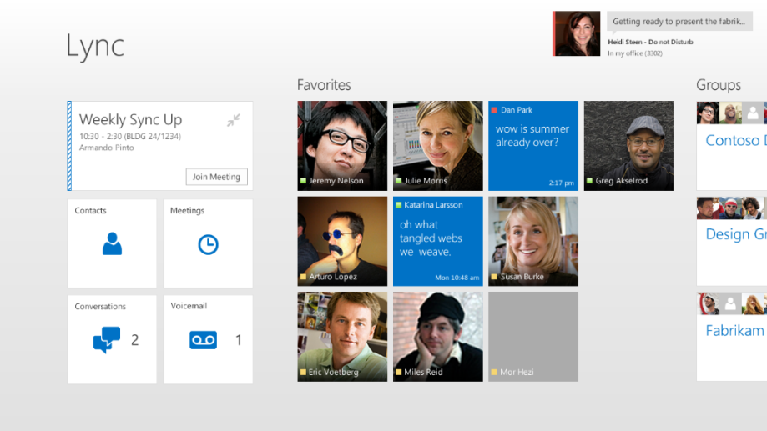
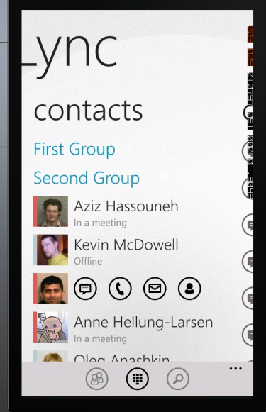
Mobile Devices
Notes:
Talk about the familiar look and feel across the different platforms, PC, tablets, and phones.
40029
01: Introduction to the New Microsoft Lync Features and Functionality

Slide 28
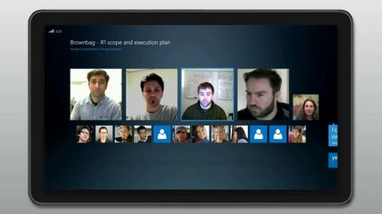
Lync 2013 on a tablet
Group chat on a tablet
Lync on a phone is initially focused for mobile connectivity while Lync client on a tablet is focused on stable business environment.
Notes:
Common Issues and Troubleshooting Tips
Common Issue: A user on a non-domain joined computer with Lync installed is not able to sign in.
Troubleshooting Tip: As with the previous versions of Lync and Office Communicator, the computer must trust the certificates presented by Lync Server. Import the internal Certificate Authority Root Certificate into the Trusted Root Certificate Authority certificate store.
Review Questions
Question
Name at least three features that are new to Lync.
Answer
Any one of the following is correct.
Communicating and Connecting in Lync
Using Voice and Video for a lifelike experience with web conference and Office integration
Collaborating and conducting meetings in real time with optimal experiences from Lync Web App, video, and audio conferencing
Conduct conferences across your mobile devices, using web conferencing tools and hosted services
Use the Virtual Desktop Infrastructure (VDI) Plug-in to sign into the Lync client that is running on the virtual machine, and participate in real-time audio and video communication

Slide 29

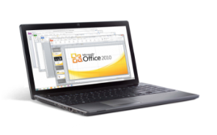
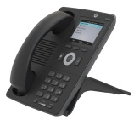




Lync Devices
Choice of phones, headsets, webcams, PCs, and conference room devices
Interoperable and designed for Lync options
Telephony and UC specific solutions
@ home
in the office
on the go
29
Notes:
Use this slide to reiterate the variety of choices across Lync devices and the interoperability designed into Lync telephony and UC solutions.
40029
01: Introduction to the New Microsoft Lync Features and Functionality

Slide 30
Web Conferencing Tools
Web Conferencing enables users to:
Share and collaborate on documents during conferences and meetings
Collaborate using white board, meeting notes, shared notebooks, and OneNote
Share all or part of the desktop with others in real time
Experience virtual meetings as though all participants are in a single conference room
Enjoy real-time audio and video communications among attendees
Add IM, video, program sharing, desktop sharing, or web conferencing to any conversation
Notes:
40029
01: Introduction to the New Microsoft Lync Features and Functionality

Slide 31
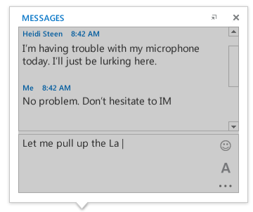
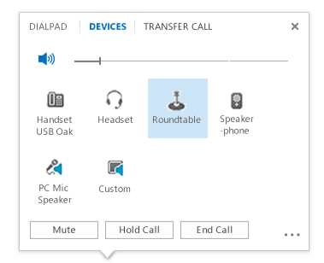
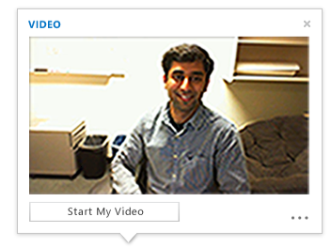
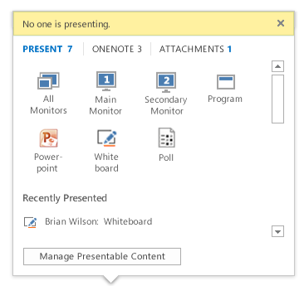
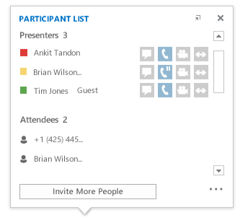
Conferencing and Hosted Service
IM
Audio
Video
Sharing
Roster
Notes:
Talk through and demo each of the views in this slide and how they all interconnect for a fully collaborative experience.
40029
01: Introduction to the New Microsoft Lync Features and Functionality

Slide 32
Summary of improved video features
Video now has face detection and smart framing, so that a participant’s video moves to help keep him or her centered in the frame.
High-def video ( 1080p resolution (1280 x 720); 16:9 aspect ration) for all conferences.
Lync meeting participants can select from different meeting layouts:
  Gallery View shows all participants’ photos or video
  Speaker View shows the meeting content and only the presenter’s video or photo;
  Presentation View shows meeting content only; Compact View shows just the meeting controls.
Gallery feature: Conference members can now see multiple video feeds at the same time. The conference view has a maximum of five live participants, the video feeds of only the most active participants appear in the top row, and photos appear for the other participants.
Notes:
40029
01: Introduction to the New Microsoft Lync Features and Functionality

Slide 33
Continuation
Participants can use video pinning (think of pinning a desktop program and choose one or more of the available video feeds to be visible at all times.
Presenters can use the “video spotlight” feature to select one participant’s video feed so that every other participant in the meeting sees that participant only.
Lync now has split audio & video, where participants can add their video stream in a conference but dial into the meeting audio.
The H.264 video codec is now the default for encoding video on Lync 2013 Preview clients. H.264 video supports a greater range of resolutions and frame rates, and improves video scalability.
Lync now has over 100 keyboard shortcuts
Lync has integration with OneNote
Lync has clients for Iphone, Ipad, Android, and Nokia phones

Slide 34
Lync Server 2013 Administration Tools
Lync Server Deployment Wizard Use to deploy Lync Server and to install all administrative tools.
Lync Server Topology Builder Use to define components in your deployment.
Lync Server Control Panel Use for ongoing management of your deployment by using a web-based interface.
Lync Server Management Shell Use for ongoing management of your deployment by using the command line.
Lync Server Logging tool Use to troubleshoot problems in your deployment.

Slide 35
Lesson 5:
Virtual Desktop Infrastructure (VDI) Plug-in
Virtual Desktop Infrastructure Plug-in Features
  Use your own physical client to connect your audio & video feeds
Notes:
40029
01: Introduction to the New Microsoft Lync Features and Functionality

Slide 36










VDI Plug-in Features
Legend:
Signaling
Media
PSTN
Lync Server 2013
IM,
Presence,
Data
Collaboration,
App Integration
Audio & Video
Remote Desktop Client
Remote Desktop Servers
Notes:
Discuss the VDI environment and talk through scenarios where students might utilize a VDI environment and the advantages of connecting through audio and video devices.

Slide 37
Lync 2013 URL links
Clients: http://office.microsoft.com/en-us/lync-help/whats-new-in-lync-2013-HA102927099.aspx
http://office.microsoft.com/en-us/whats-new-in-lync-2013-HA102927099.aspx
Reference Cards: http://office.microsoft.com/en-us/quick-reference-cards-about-lync-HA103433496.aspx
TechNet: http://technet.microsoft.com/library/gg398616(v=ocs.15)
Lync Server 2013 for IT pros http://technet.microsoft.com/en-us/lync/fp123621
What is Lync http://lync.microsoft.com/en-us/what-is-lync/Pages/what-is-lync.aspx?Title=partner-solutions&tabID=5&itemID=7
Notes:
40029
01: Introduction to the New Microsoft Lync Features and Functionality

Slide 38
Upcoming Webinars
Free Webinar: Windows 8 Virtualization
Free Webinar: Extending Configuration Manager 2012 SP1 via PowerShell 3.0
Free Webinar: SharePoint 2010 Review | Courses & Certifications
Free Webinar: Windows 8 Development | HTML5 with Live Demo
Free Webinar: Microsoft SQL Server 2012 | EIM Capabilities
Free Webinar: Lync Server 2013 Part 2 | Architecture and Deployment Changes
Free Webinar: Microsoft SQL Server 2012 | Business Intelligence & Cloud Solutions
Free Webinar: Lync Server 2013 Part 3 | Integration and Extensibility
Sign up for free at: www.netcomlearning.com/webinars

Slide 39
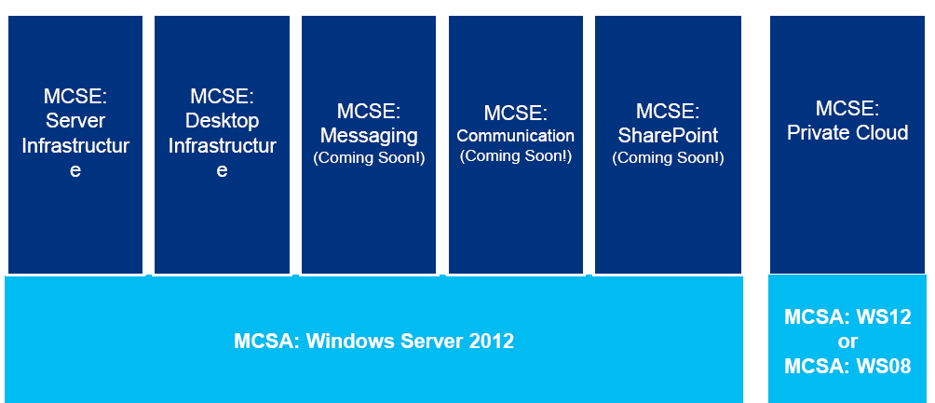

MCSA: Windows Server 2012

Slide 40
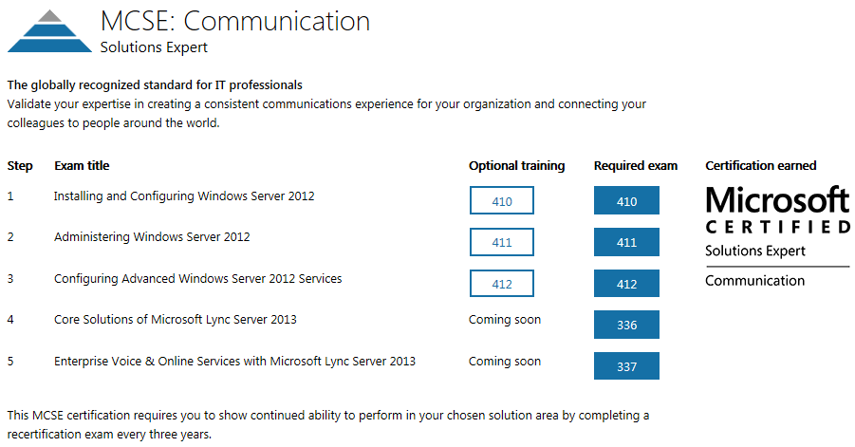

MCSE: Communication

Slide 41
MCSE: Communication
MCSE: Communication
  20336: Core Solutions of Microsoft Lync Server 2013
  20337: Enterprise Voice and Online Services with Microsoft Lync Server 2013
Upcoming Class:
  March 18th in New York City & Live Online (course 20336 only)
** Contact us for Lync Server 2010 Certification Schedules
Locations: Attend in-class or Live Online Instructor-led
  New York
  Las Vegas (All Inclusive Travel Package)
  Arlington VA
  Philadelphia, PA
*Free Second Shot Exam is Back

Slide 42


Thank You!
Stick Around for Q&As
Notes:
2:00 pm

